Slide 1
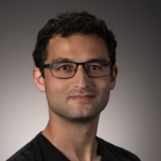
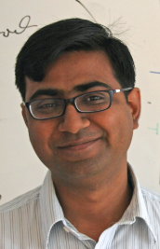
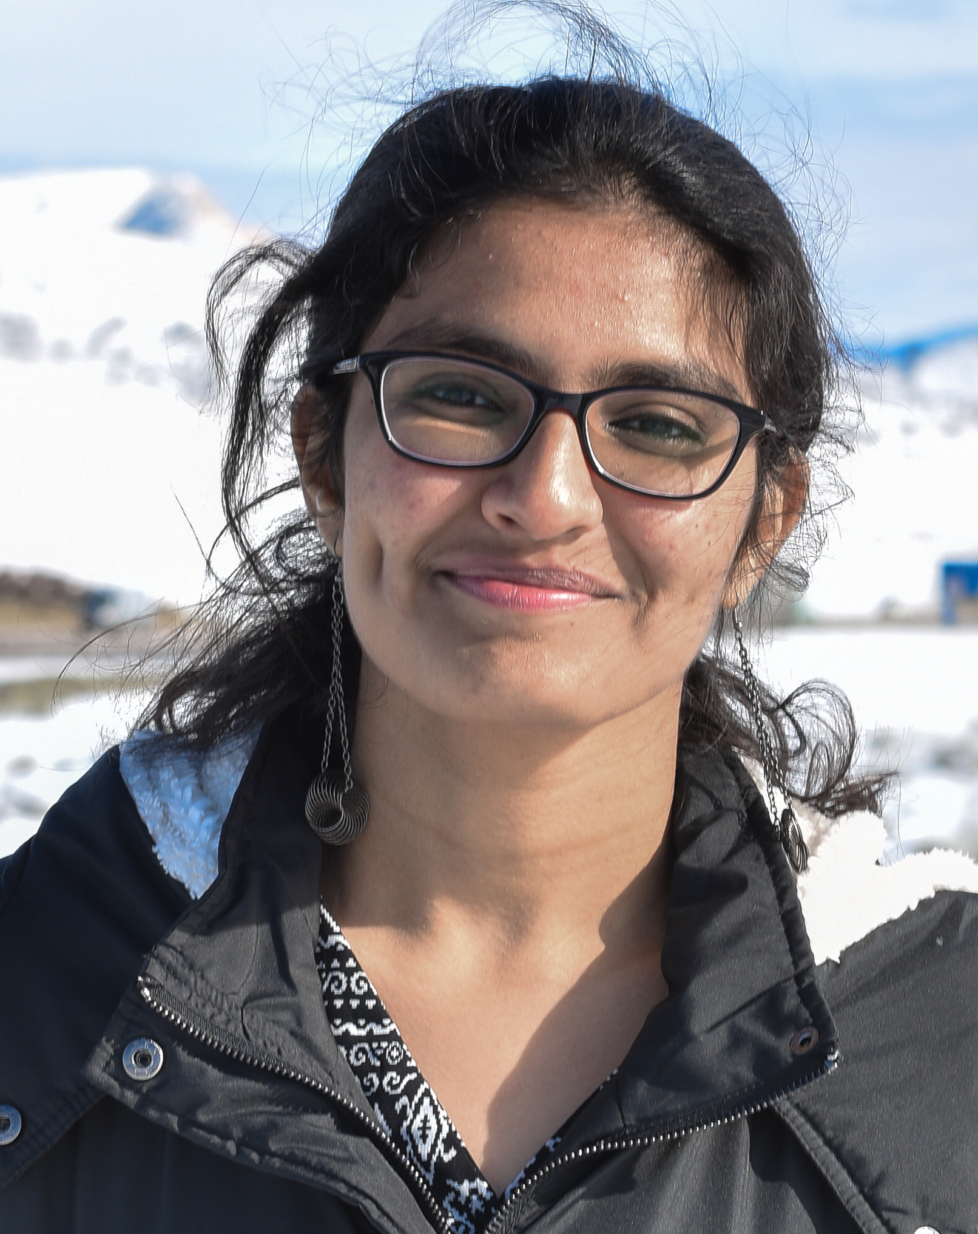
Invitation to FPT Approximation via Cut and Coverage Problems
Daniel Lokshtanov
Saket Saurabh
Vaishali Surianarayanan

Slide 2
The Story of FPT-Approximation for Partial Vertex Cover and Its Generlizations
Saket Saurabh
Institute of Mathematical Sciences
9th May 2025, IIT Dhanbad

Slide 3
FPT Approximation Algorithms for Coverage and Satisfiability Problems
Saket Saurabh
Institute of Mathematical Sciences
6th June 2025, CAALM 2025

Slide 4
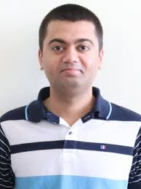
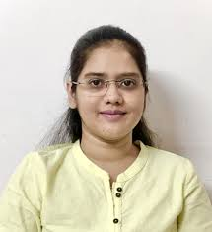
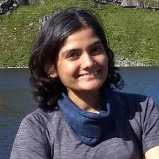
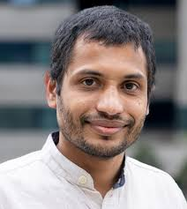
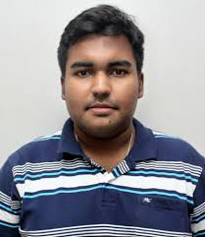
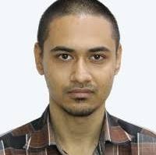
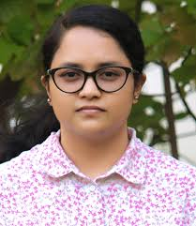
Joint work with

Slide 5
Message of this talk
To develop algorithms that are
faster than known FPT algorithms and
achieve better approximation factors than what is possible in polynomial time.
Or find reasons for our failure to do so!

Slide 6
Maximum Coverage
Input: A universe U of n elements and m subsets F={S₁, S₂,….,S_{m}} and an integer k.
Maximum Coverage Problem: Find k sets such that its union is as large as possible.
Set Cover: Find a minimum number of sets such that its union covers the universe U.

Slide 7
Maximum Coverage
Input: A universe U of n elements and m subsets F={S₁, S₂,….,S_{m}} and an integer k.
Maximum Coverage Problem: Find k sets such that its union is as large as possible.
Set Cover: Find a minimum number of sets such that its union covers the universe U.

Slide 8
Maximum Coverage
Input: A universe U of n elements and m subsets F={S₁, S₂,….,S_{m}} and an integer k.
Maximum Coverage Problem: Find k sets such that its union is as large as possible.

Slide 9
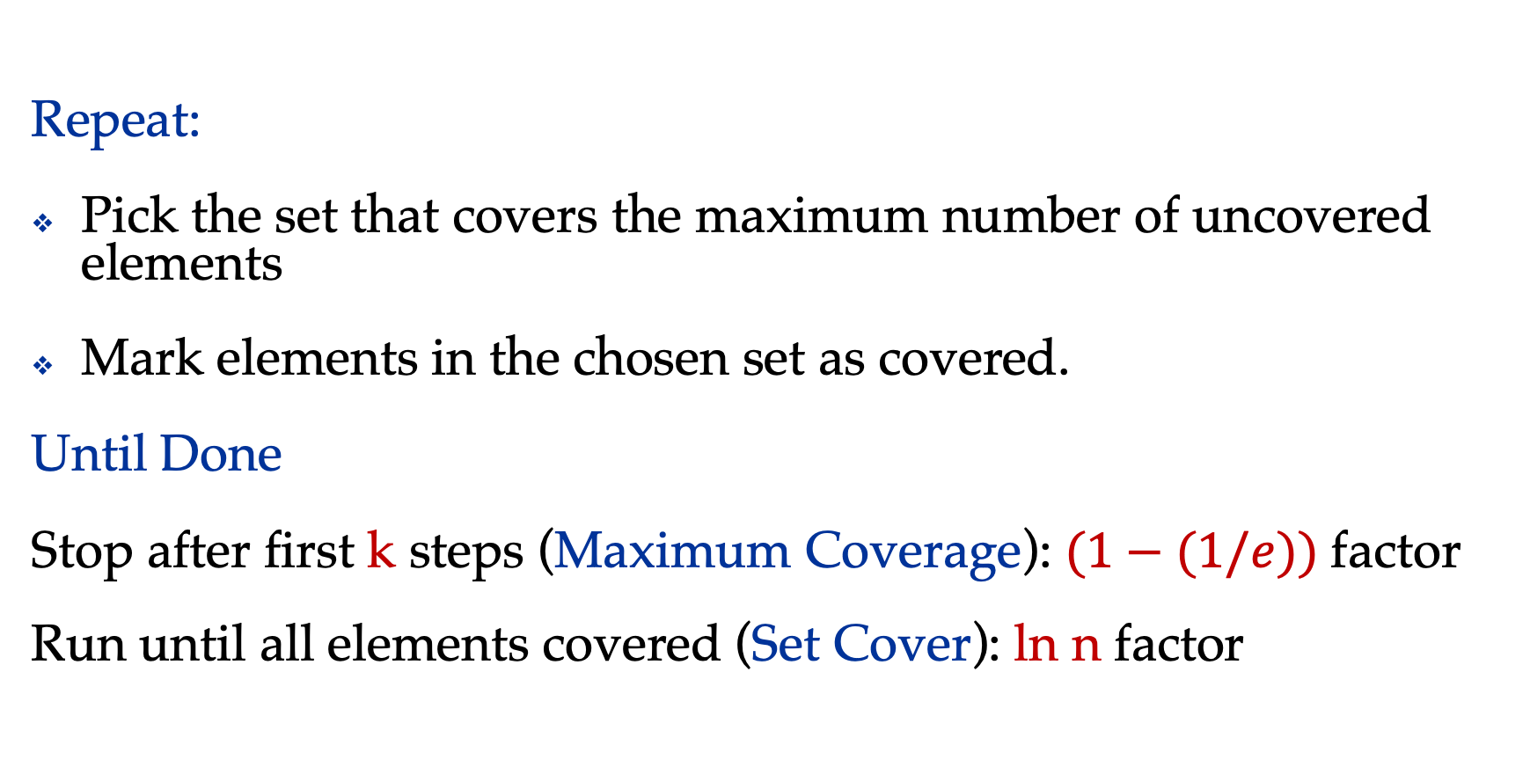
Greedy Coverage
Repeat:
Pick the set that covers the maximum number of uncovered elements
Mark elements in the chosen set as covered.
Until Done
Stop after first k steps (Maximum Coverage): $(1−(1/e))$factor
Run until all elements covered (Set Cover): ln n factor

Slide 10
Polynomial Time Hardness
Theorem:
Unless P=NP, there is no c>0, such that Maximum Coverage
admits (1-(1/e))-c factor approximation algorithm.

Slide 11
Maximum Coverage with Parameters
Input: A universe U of n elements and m subsets F={S₁, S₂,….,S_{m}}
and integers k, t.
Problem: Find k sets such that its union is at least t
Parameters: k, t, k+t

Slide 12
FPT Results for Maximum Coverage
Lemma: Unless FPT=W[1], there is no f(k) n^{O(1)} time algorithm
for Maximum Coverage.
Lemma: Maximum Coverage admits 2^{O(t)} n^{O(1)} time algorithm.

Slide 13
FPT and Approximation
Approximation Hardness in P and Exact Hardness in FPT
Natural to combine Approximation and FPT
Maximum Coverage via FPT-Approximation

Slide 14
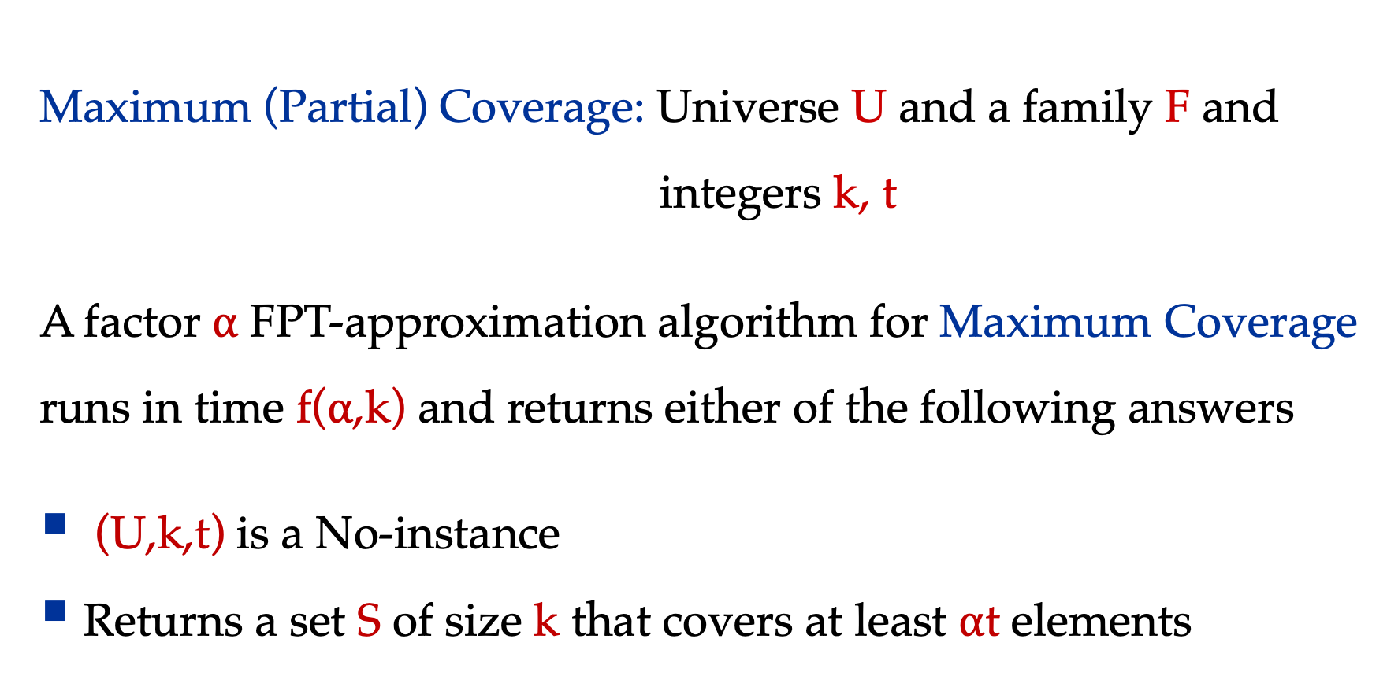
Question 1: Approximating the covered
Maximum (Partial) Coverage: Universe U and a family F and
integers k, t
A factor $α$ FPT-approximation algorithm for Maximum Coverage
runs in time f($α$,k) and returns either of the following answers
(U,k,t) is a No-instance
Returns a set S of size k that covers at least $α$t elements

Slide 15
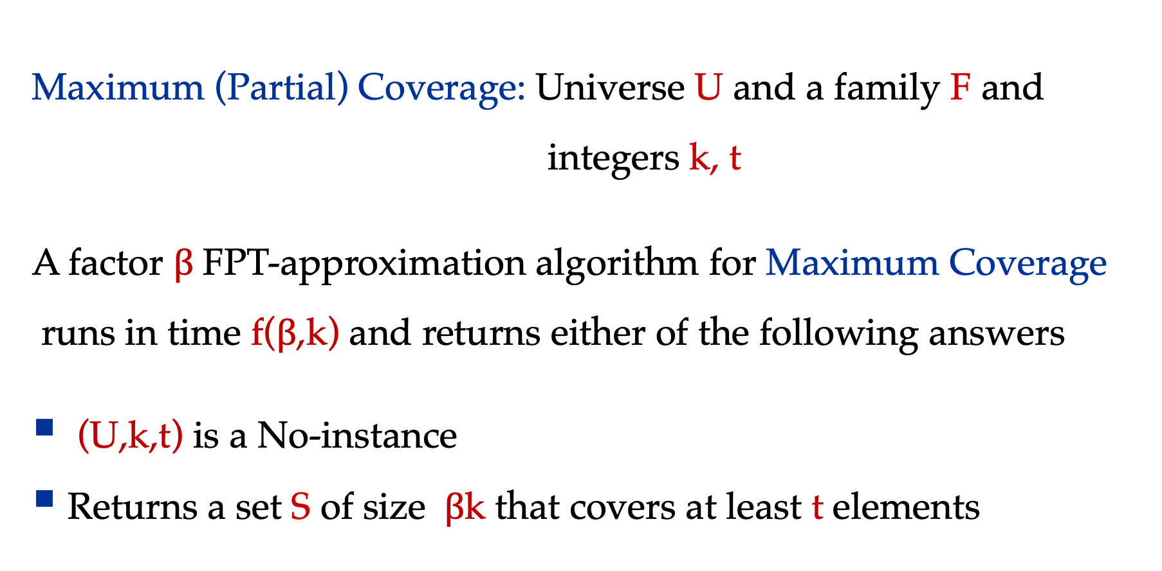
Question 2: Approximating the one that covers
Maximum (Partial) Coverage: Universe U and a family F and
integers k, t
A factor $β$ FPT-approximation algorithm for Maximum Coverage
runs in time f($β$,k) and returns either of the following answers
(U,k,t) is a No-instance
Returns a set S of size $β$k that covers at least t elements

Slide 16
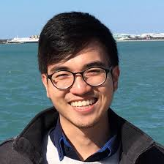
What do we know about hardness in FPT
Theorem [Manurangsi]
For any constant c>0 and any function h, assuming Gap-ETH,
no h(k)(n+m)^{o(k)} time algorithm can approximate Maximum Coverage with n elements and m sets
to within a factor ((1-(1/e)-c)
even with a promise that there exist k sets that fully cover the whole universe
Beating Greedy is hard even in FPT!

Slide 17

Reasons/Hypothesis for our failure to design algorithms.

Slide 18
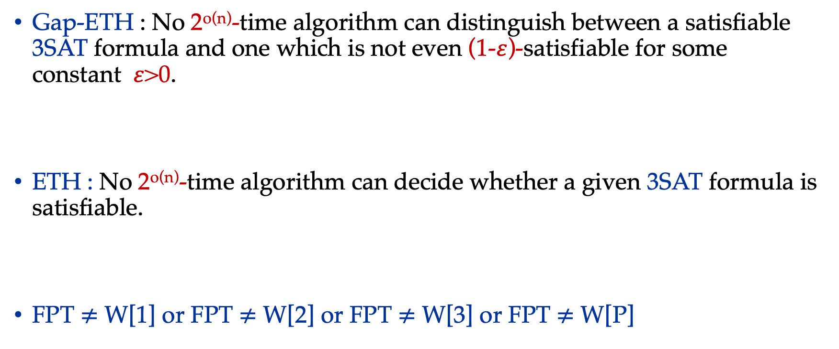
Hypothesis
Gap-ETH : No 2^{o(n)}-time algorithm can distinguish between a satisfiable 3SAT formula and one which is not even (1-$ε$)-satisfiable for some constant 𝜀>0.
ETH : No 2^{o(n)}-time algorithm can decide whether a given 3SAT formula is satisfiable.
FPT $≠$ W[1] or FPT $≠$ W[2] or FPT $≠$ W[3] or FPT $≠$ W[P]

Slide 19
Parameterized Inapproximability
Hypothesis (PIH) – Analog of PCP for PC
PIH : It asserts that there exists some 𝜀>0, such that it is W[1]-hard to distinguish
  if a 2-CSP instance on k variables (k is the parameter) and alphabet size n is completely satisfiable
  or if every assignment to its variables satisfies at most 1 − 𝜀 fraction of the constraints
Gap-ETH implies PIH
ETH implies PIH [Guruswami, Lin, Ren, Sun, and Wu, STOC 2024]

Slide 20
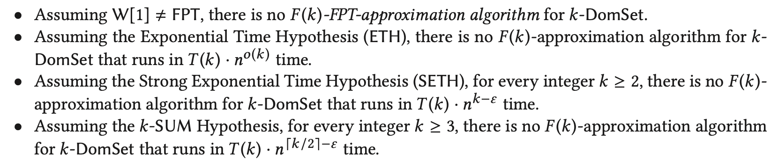
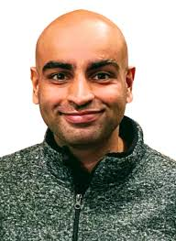

Set Cover /Dominating Set
This result circumvents PIH.

Slide 21
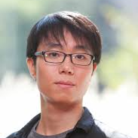
Max Coverage
Known FPT-Inapproximability Results are via ETH, Gap-ETH, or via PIH.
Could we circumvent PIH for Max Coverage similar to the Set Cover problem?
Parameterized gap preserving reduction from Max Coverage to 2-CSP which shows circumventing PIH seems difficult.

Slide 22
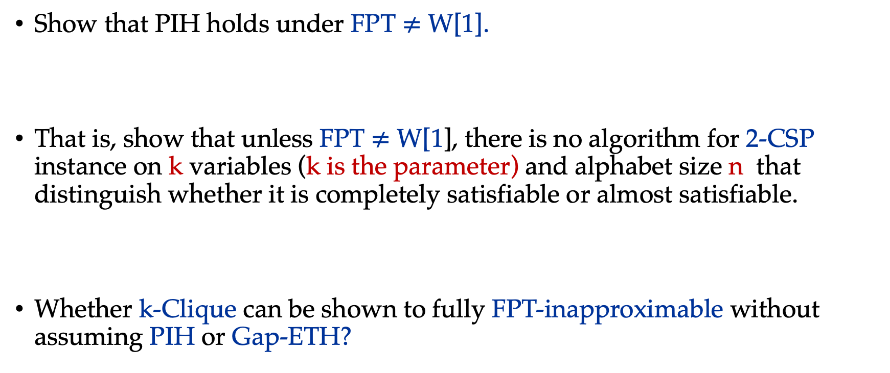
Open Problems
Show that PIH holds under FPT $≠$ W[1].
That is, show that unless FPT $≠$ W[1], there is no algorithm for 2-CSP instance on k variables (k is the parameter) and alphabet size n that distinguish whether it is completely satisfiable or almost satisfiable.
Whether k-Clique can be shown to fully FPT-inapproximable without assuming PIH or Gap-ETH?

Slide 23
End of Detour to Inapproximability!
Message
Coverage problem on general instances is as hard in FPT time as in polynomial time!

Slide 24
Special Instances
Each set is bounded – d set-family
Each element appears in small number of sets - bounded
frequency
Incidence graphs belongs to some special graphs

Slide 25
Special Instances
Each set is bounded – d set-family
Each element appears in small number of sets – bounded
frequency
Incidence graph belongs to some special graphs

Slide 26
Special Instances: Hardness
Each set is bounded – d set-family
Each element appears in small number of sets - bounded
frequency
Approximable within 0.929 and is hard to approximate within 0.944, assuming UGC [frequency 2]
Incidence Graphs belongs to some special family of graphs

Slide 27
Incidence Graphs
1
S₁
U={1,2,3,4,5,6}
S₁={1,2,3}
S₂={4,5,6}
S₃={2,4,6}
S₄={3,5}
2
S₂
3
S₃
4
5
S₄
6
A
B

Slide 28
Special Instances
Each set is bounded – d set-family
Each element appears in small number of sets – bounded
frequency
Incidence graph belongs to some special graphs
Such as planar, bounded degree, no-where dense graphs and
what not!

Slide 29
Special Instances
Each set is bounded – d set-family
- Each vertex in A has degree at most d
Each element appears in small number of sets – frequency d
- Each vertex in B has degree at most d
Incidence graph belongs to some special graphs
Such as planar, bounded degree, no-where dense graphs and
what not!

Slide 30
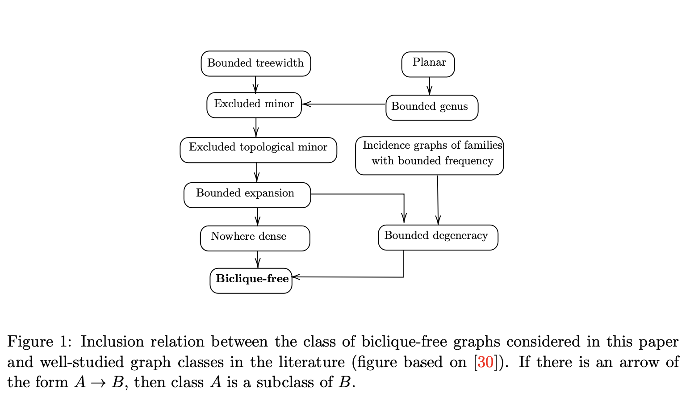
Graph Class Inclusions

Slide 31
Max Coverage
Known FPT-Inapproximability Results are via ETH, Gap-ETH, or via PIH.
Could we circumvent PIH for Max Coverage similar to the Set Cover problem?
Parameterized gap preserving reduction from Max Coverage to 2-CSP which shows circumventing PIH seems difficult.

Slide 32
Maximum Coverage via Incidence Graph
Input: A universe U of n elements and m subsets F={S₁, S₂,….,S_{m}}
and integers k, t.
Question: Find k vertices in A, such that |N(A)| is at least t.

Slide 33
Partial Hitting Set via Incidence Graph
Input: A universe U of n elements and m subsets F={S₁, S₂,….,S_{m}}
and integers k, t.
Question: Find k vertices in B, such that |N(B)| is at least t.
Partial Vertex Cover (PVC): If each set in F has size 2.
Parameters: k, t

Slide 34
Partial Hitting Set in FPT: Problem Definitions
Input: A universe U of n elements and m subsets F={S₁, S₂,….,S_{m}} and integers k, t.
Partial Hitting Set Problem: Find k elements in U (if exists) such that it intersects at least t elements
Parameters: k, t, k+t
Partial Vertex Cover: If each set in F has size 2.
Parameters: k, t, k+t

Slide 35
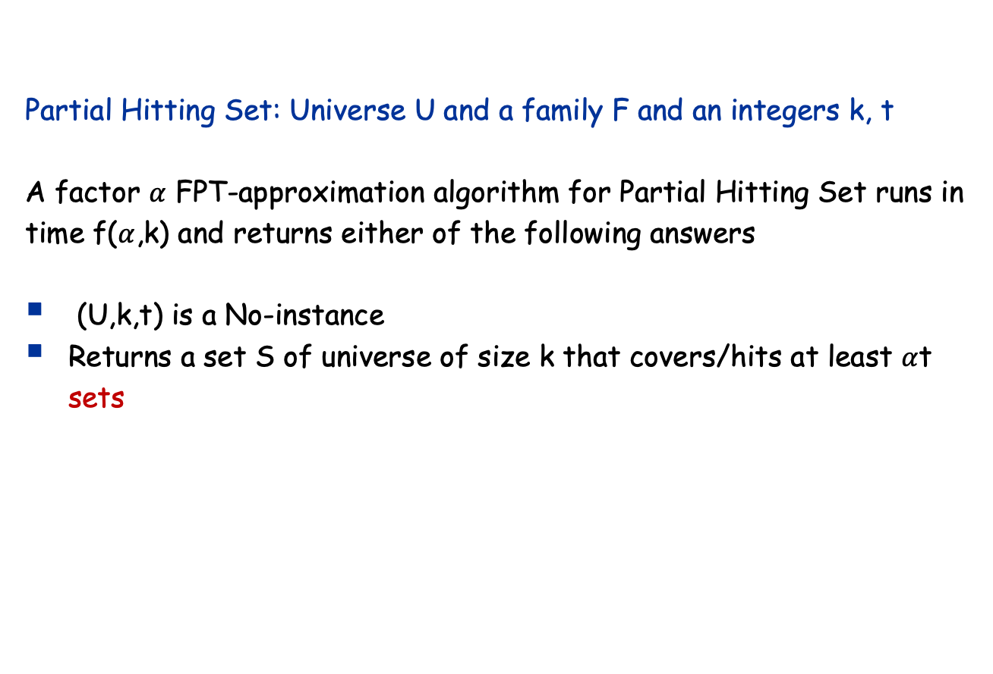
Question 1: Approximating the number of covered sets
Partial Hitting Set: Universe U and a family F and an integers k, t
A factor $α$ FPT-approximation algorithm for Partial Hitting Set runs in time f($α$,k) and returns either of the following answers
(U,k,t) is a No-instance
Returns a set S of universe of size k that covers/hits at least $α$t sets

Slide 36
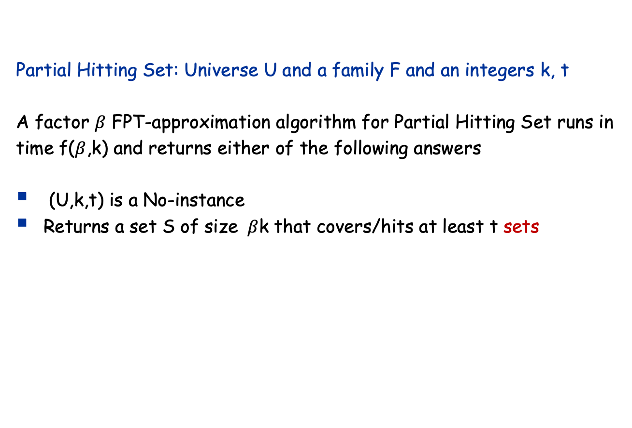
Question 2: Approximating the Number of elements for hitting
Partial Hitting Set: Universe U and a family F and an integers k, t
A factor $β$ FPT-approximation algorithm for Partial Hitting Set runs in time f($β$,k) and returns either of the following answers
(U,k,t) is a No-instance
Returns a set S of size $β$k that covers/hits at least t sets

Slide 37
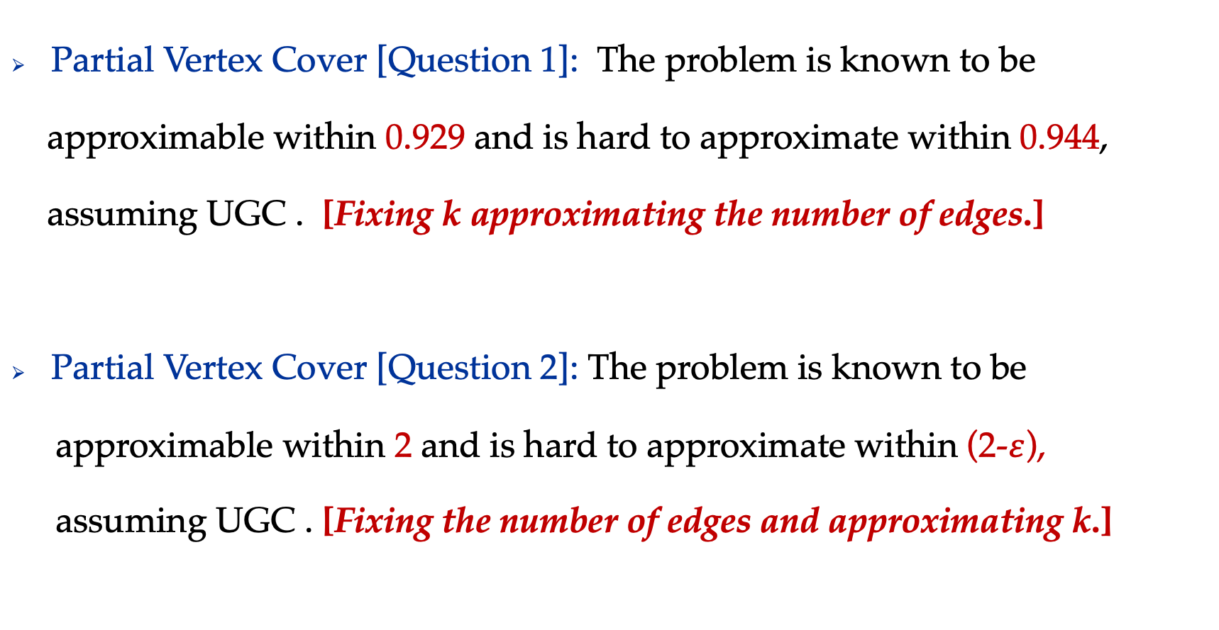
Known Results for Partial Vertex Cover
Partial Vertex Cover [Question 1]: The problem is known to be
approximable within 0.929 and is hard to approximate within 0.944,
assuming UGC . [Fixing k approximating the number of edges.]
Partial Vertex Cover [Question 2]: The problem is known to be
approximable within 2 and is hard to approximate within (2-$ε$),
assuming UGC . [Fixing the number of edges and approximating k.]

Slide 38
Known Results for Partial Vertex Cover
Unless FPT=W[1], there is no f(k) n^{O(1)} time algorithm for
Partial Vertex Cover.
Partial Vertex Cover admits 2^{O(t)} n^{O(1)} time algorithm.

Slide 39
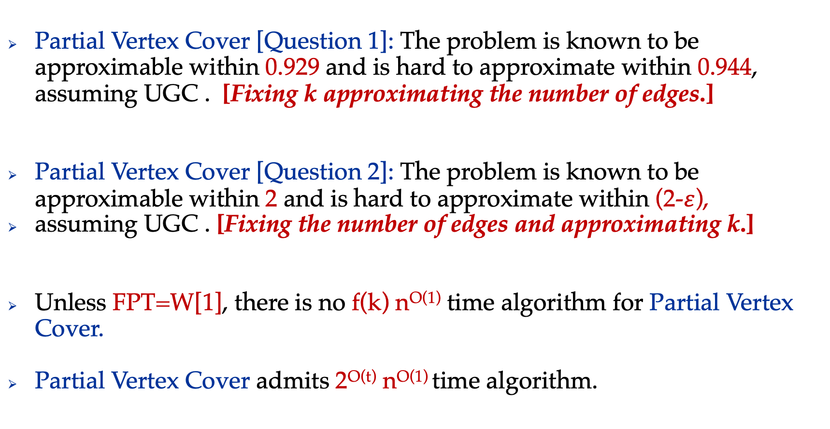
What do we know about Partial Vertex Cover
Partial Vertex Cover [Question 1]: The problem is known to be approximable within 0.929 and is hard to approximate within 0.944, assuming UGC . [Fixing k approximating the number of edges.]
Partial Vertex Cover [Question 2]: The problem is known to be approximable within 2 and is hard to approximate within (2-$ε$),
assuming UGC . [Fixing the number of edges and approximating k.]
Unless FPT=W[1], there is no f(k) n^{O(1)} time algorithm for Partial Vertex Cover.
Partial Vertex Cover admits 2^{O(t)} n^{O(1)} time algorithm.

Slide 40
Known Results: Max Coverage
Skowron and Faliszewski showed that, if we are working on
set families, with frequency d, then there exists an algorithm,
    that given a c>0, runs in time (d/c)^{k} n^{O(1)} and
    either returns that input is a no instance or
    returns a subfamily F' of size k that covers at least (1-c)t elements.
[These algorithms are said FPT-Approximation Schemes (EPAS)]

Slide 41
Known Results: Max Coverage and PHS
Marx gave the first EPAS for Partial Vertex Cover, followed by
several algorithms.
Manurangsi + Skowron and Faliszewski, independently, gave
EPAS for PVC (given a c>0, runs in time (d/c)^{k} n^{O(1)} )
Algorithms can be generalized to the version when sets have size d.

Slide 42
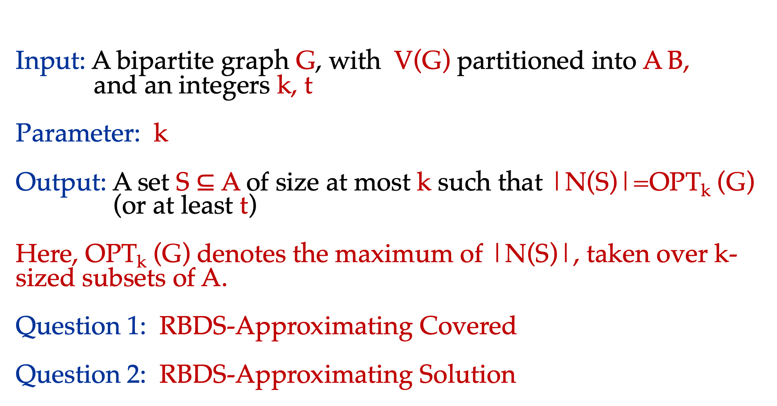
Red Blue Dominating Set (RBDS)
Input: A bipartite graph G, with V(G) partitioned into A B,
and an integers k, t
Parameter: k
Output: A set S $⊆$ A of size at most k such that |N(S)|=OPT_{k} (G)
(or at least t)
Here, OPT_{k} (G) denotes the maximum of |N(S)|, taken over k-sized subsets of A.
Question 1: RBDS-Approximating Covered
Question 2: RBDS-Approximating Solution

Slide 43
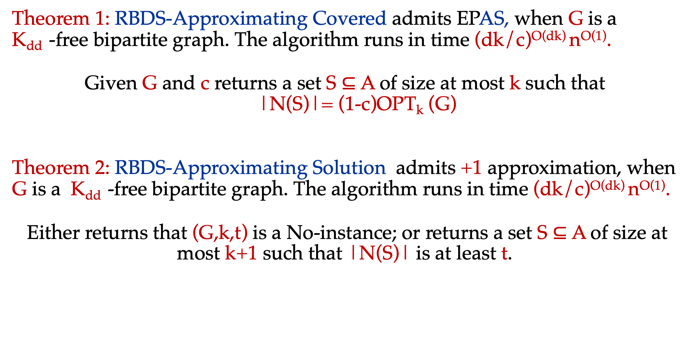
Our Results
Theorem 1: RBDS-Approximating Covered admits EPAS, when G is a
K_{dd} -free bipartite graph. The algorithm runs in time (dk/c)^{O(dk)} n^{O(1)}.
Given G and c returns a set S $⊆$ A of size at most k such that
|N(S)|= (1-c)OPT_{k} (G)
Theorem 2: RBDS-Approximating Solution admits +1 approximation, when G is a K_{dd} -free bipartite graph. The algorithm runs in time (dk/c)^{O(dk)} n^{O(1)}.
Either returns that (G,k,t) is a No-instance; or returns a set S $⊆$ A of size at most k+1 such that |N(S)| is at least t.

Slide 44
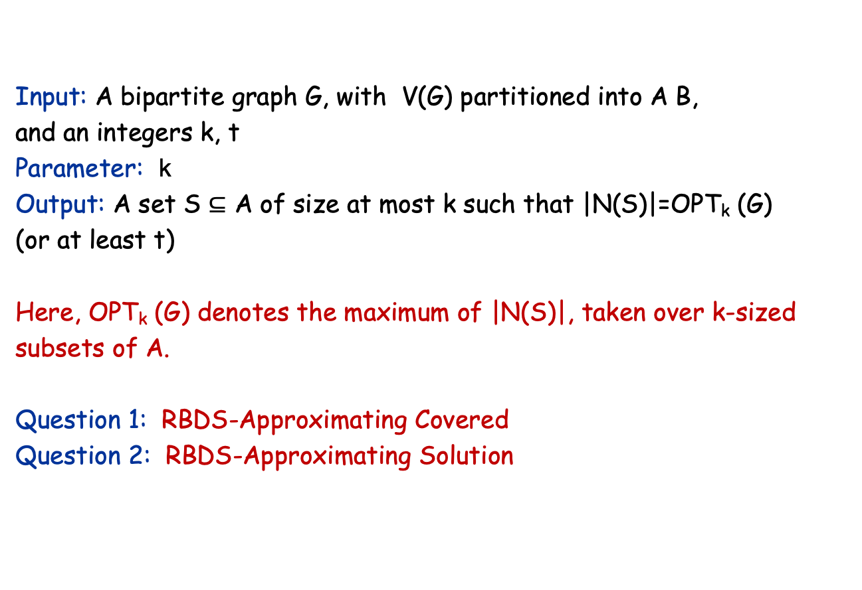
Red Blue Dominating Set (RBDS)
Input: A bipartite graph G, with V(G) partitioned into A B,
and an integers k, t
Parameter: k
Output: A set S $⊆$ A of size at most k such that |N(S)|=OPT_{k} (G)
(or at least t)
Here, OPT_{k} (G) denotes the maximum of |N(S)|, taken over k-sized subsets of A.
Question 1: RBDS-Approximating Covered
Question 2: RBDS-Approximating Solution

Slide 45
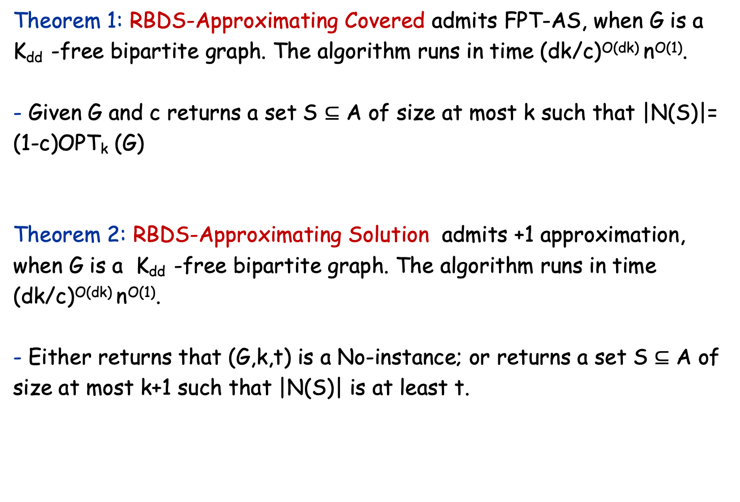
Our Results
Theorem 1: RBDS-Approximating Covered admits FPT-AS, when G is a
K_{dd} -free bipartite graph. The algorithm runs in time (dk/c)^{O(dk)} n^{O(1)}.
- Given G and c returns a set S $⊆$ A of size at most k such that |N(S)|= (1-c)OPT_{k} (G)
Theorem 2: RBDS-Approximating Solution admits +1 approximation, when G is a K_{dd} -free bipartite graph. The algorithm runs in time (dk/c)^{O(dk)} n^{O(1)}.
- Either returns that (G,k,t) is a No-instance; or returns a set S $⊆$ A of size at most k+1 such that |N(S)| is at least t.

Slide 46
Outline for +1 Approximation for PVC
An algorithm for PVC running in time f(k)n^{O(1)} that either
returns that there is no set of size k that covers at least t edges
OR
outputs a set of k+1 vertices that covers at least t edges.

Slide 47
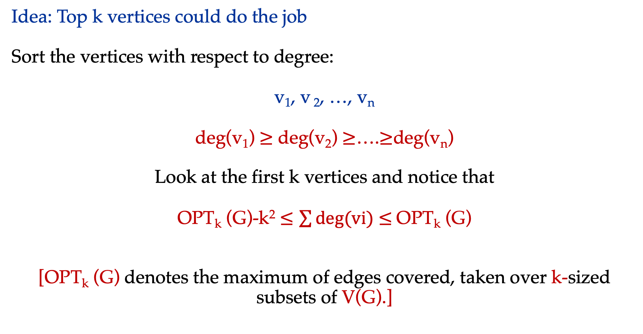
Outline for +1 Approximation for PVC
Idea: Top k vertices could do the job
Sort the vertices with respect to degree:
v₁, v ₂, …, v_{n}
deg(v₁) $≥$ deg(v₂) $≥$….$≥$deg(v_{n})
Look at the first k vertices and notice that
OPT_{k} (G)-k² $≤\sum{deg⁡(vi)}$ $≤$OPT_{k} (G)
[OPT_{k} (G) denotes the maximum of edges covered, taken over k-sized subsets of V(G).]

Slide 48
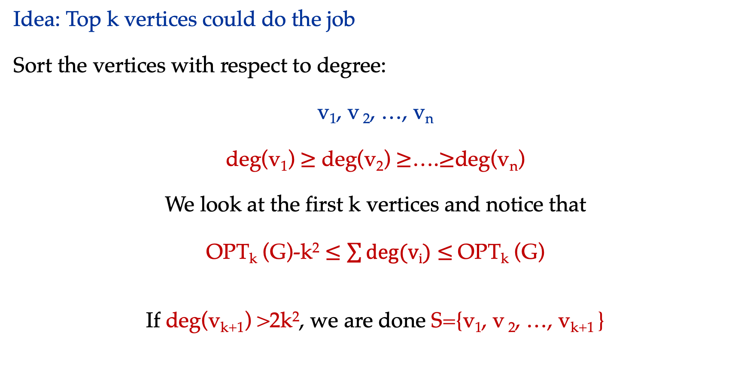
Outline for PVC+1
Idea: Top k vertices could do the job
Sort the vertices with respect to degree:
v₁, v ₂, …, v_{n}
deg(v₁) $≥$ deg(v₂) $≥$….$≥$deg(v_{n})
We look at the first k vertices and notice that
OPT_{k} (G)-k² $≤\sum{deg⁡(vi)}$ $≤$OPT_{k} (G)
If deg(v_{k+1}) >2k², we are done S={v₁, v ₂, …, v_{k+1} }

Slide 49
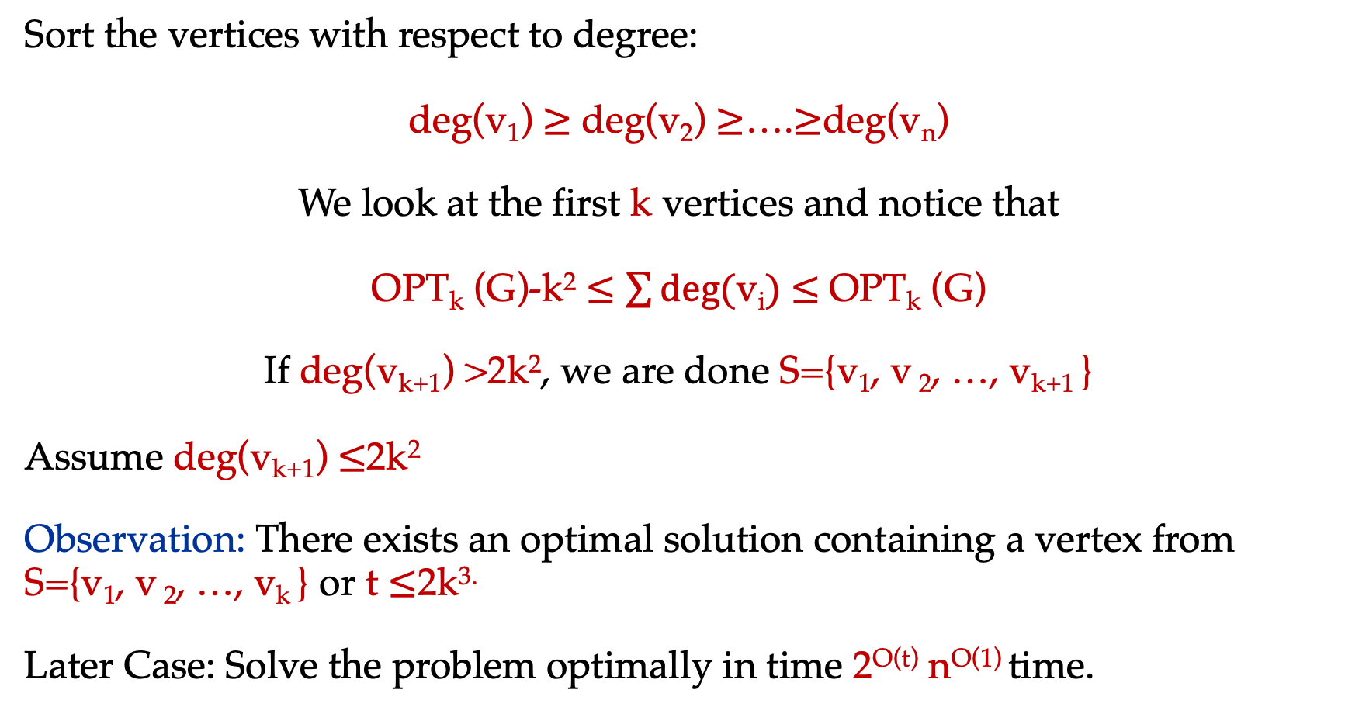
Outline for PVC+1
Sort the vertices with respect to degree:
deg(v₁) $≥$ deg(v₂) $≥$….$≥$deg(v_{n})
We look at the first k vertices and notice that
OPT_{k} (G)-k² $≤\sum{deg⁡(\text{v}\text{i})}$ $≤$OPT_{k} (G)
If deg(v_{k+1}) >2k², we are done S={v₁, v ₂, …, v_{k+1} }
Assume deg(v_{k+1}) $≤$2k²
Observation: There exists an optimal solution containing a vertex from S={v₁, v ₂, …, v_{k} } or t $≤$2k^{3.}
Later Case: Solve the problem optimally in time 2^{O(t)} n^{O(1)} time.

Slide 50
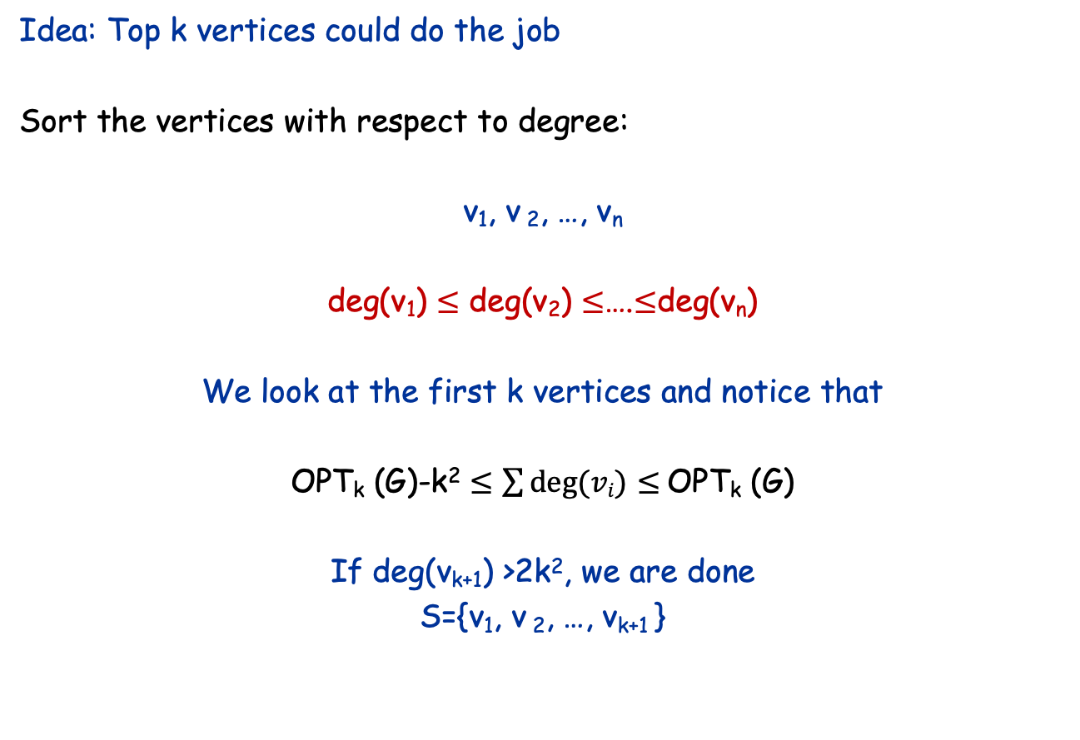
Outline for PVC +1
Idea: Top k vertices could do the job
Sort the vertices with respect to degree:
v₁, v ₂, …, v_{n}
deg(v₁) $≤$ deg(v₂) $≤$….$≤$deg(v_{n})
We look at the first k vertices and notice that
OPT_{k} (G)-k² $≤\sum{deg⁡(vi)}$ $≤$OPT_{k} (G)
If deg(v_{k+1}) >2k², we are done
S={v₁, v ₂, …, v_{k+1} }

Slide 51
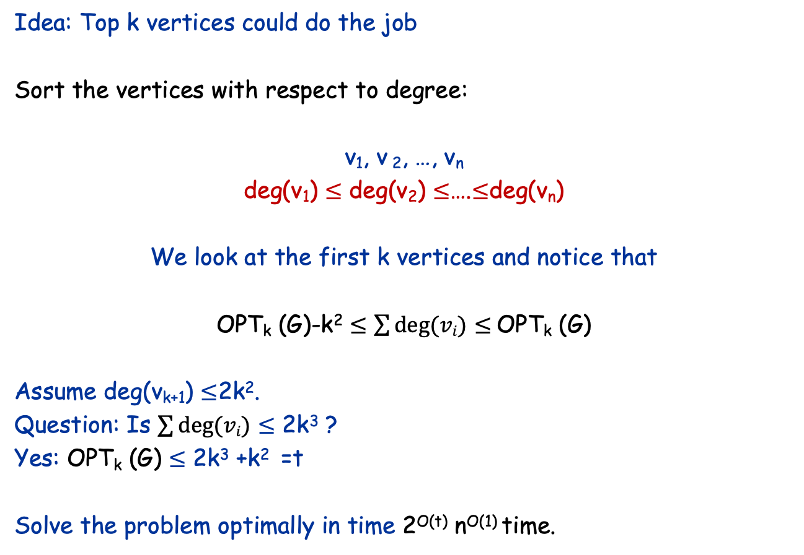
Outline for PVC +1
Idea: Top k vertices could do the job
Sort the vertices with respect to degree:
v₁, v ₂, …, v_{n}
deg(v₁) $≤$ deg(v₂) $≤$….$≤$deg(v_{n})
We look at the first k vertices and notice that
OPT_{k} (G)-k² $≤\sum{deg⁡(vi)}$ $≤$OPT_{k} (G)
Assume deg(v_{k+1}) $≤$2k².
Question: Is $\sum{deg⁡(vi)}$ $≤$ 2k³ ?
Yes: OPT_{k} (G) $≤$ 2k³ +k² =t
Solve the problem optimally in time 2^{O(t)} n^{O(1)} time.

Slide 52
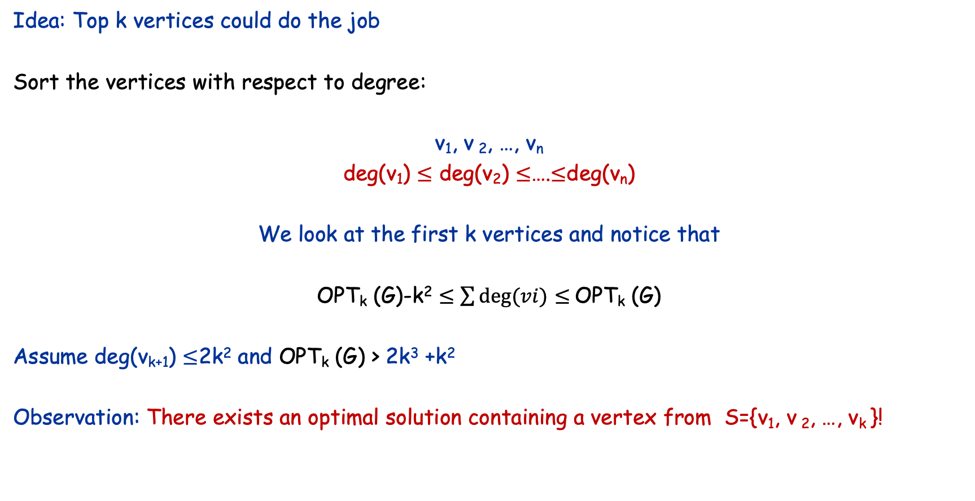
Outline for PVC +1
Idea: Top k vertices could do the job
Sort the vertices with respect to degree:
v₁, v ₂, …, v_{n}
deg(v₁) $≤$ deg(v₂) $≤$….$≤$deg(v_{n})
We look at the first k vertices and notice that
OPT_{k} (G)-k² $≤\sum{deg⁡(vi)}$ $≤$OPT_{k} (G)
Assume deg(v_{k+1}) $≤$2k² and OPT_{k} (G) > 2k³ +k²
Observation: There exists an optimal solution containing a vertex from S={v₁, v ₂, …, v_{k} }!

Slide 53

Outline for PVC +1
(G,k) is a yes-instance
if and only if
$⋁$(G-v,k-1) is a yes-instance
v in S={v₁, v ₂, …, v_{k} }

Slide 54
Outline for PVC +1
T(k)=k T(k-1) + n^{O(1)} 2^{O(t)}, here t=O(k³).
This solves to n^{O(1)} 2^{O(t)}, here t=O(k³).

Slide 55
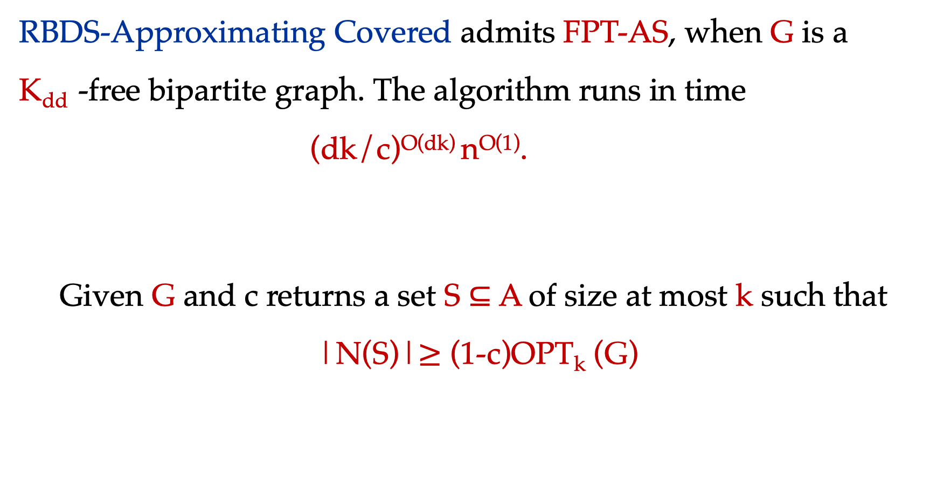
Our Results
RBDS-Approximating Covered admits FPT-AS, when G is a
K_{dd} -free bipartite graph. The algorithm runs in time
(dk/c)^{O(dk)} n^{O(1)}.
Given G and c returns a set S $⊆$ A of size at most k such that
|N(S)|$≥$ (1-c)OPT_{k} (G)

Slide 56
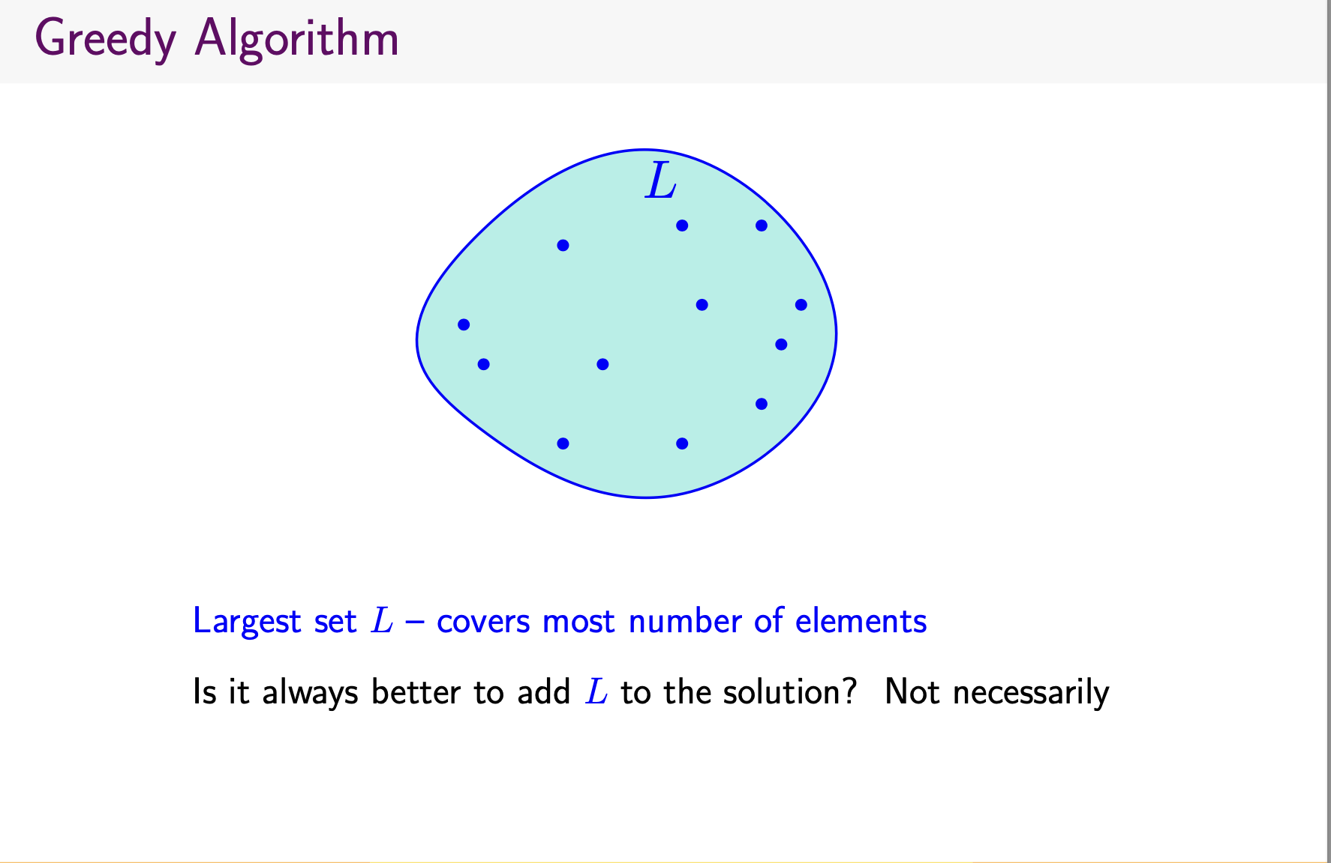

Slide 57
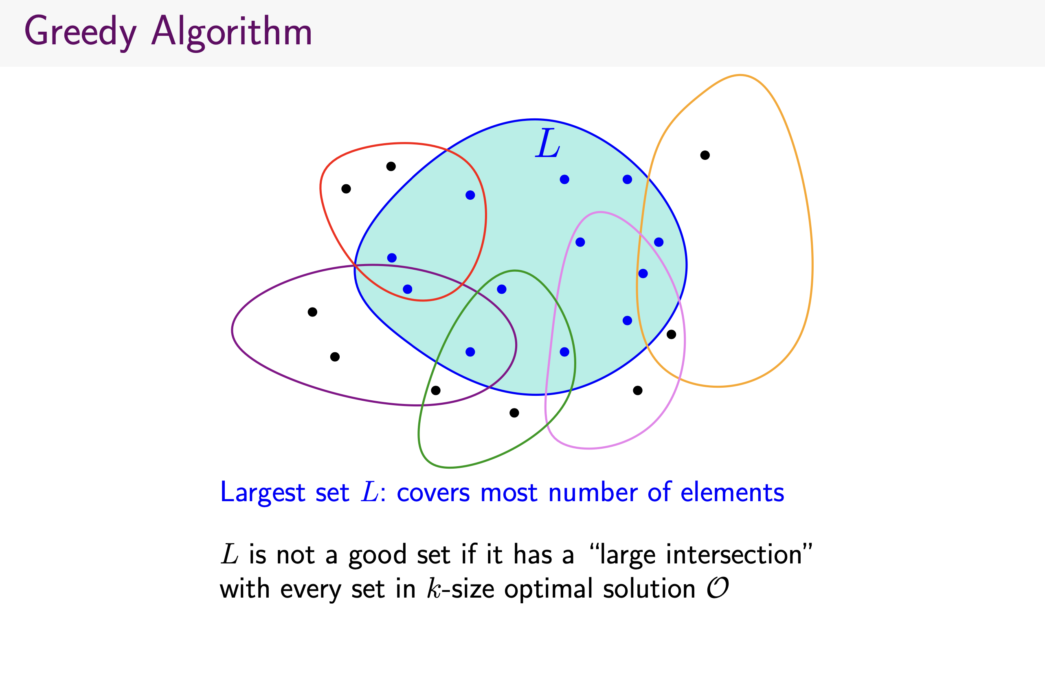

Slide 58
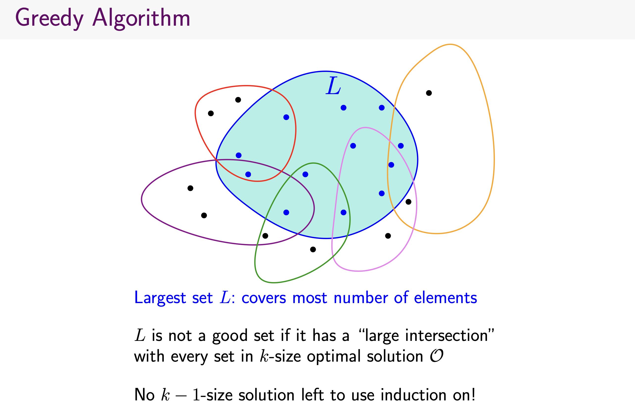

Slide 59
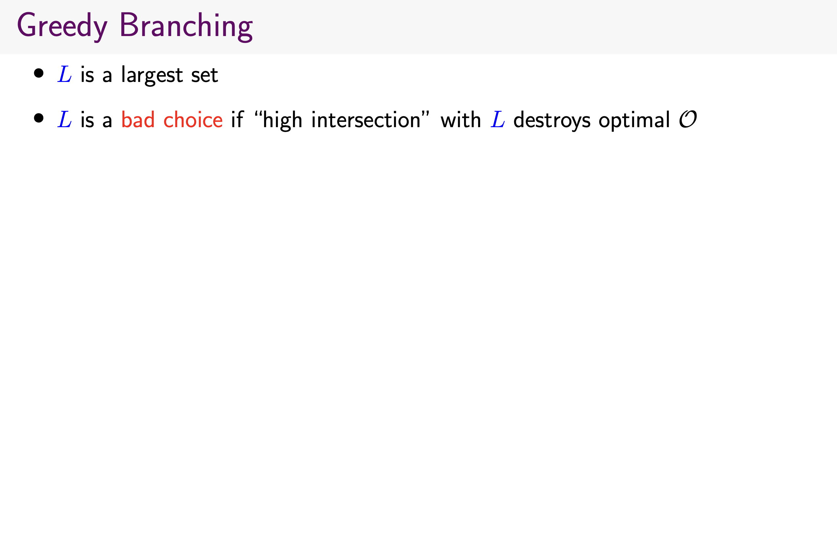

Slide 60
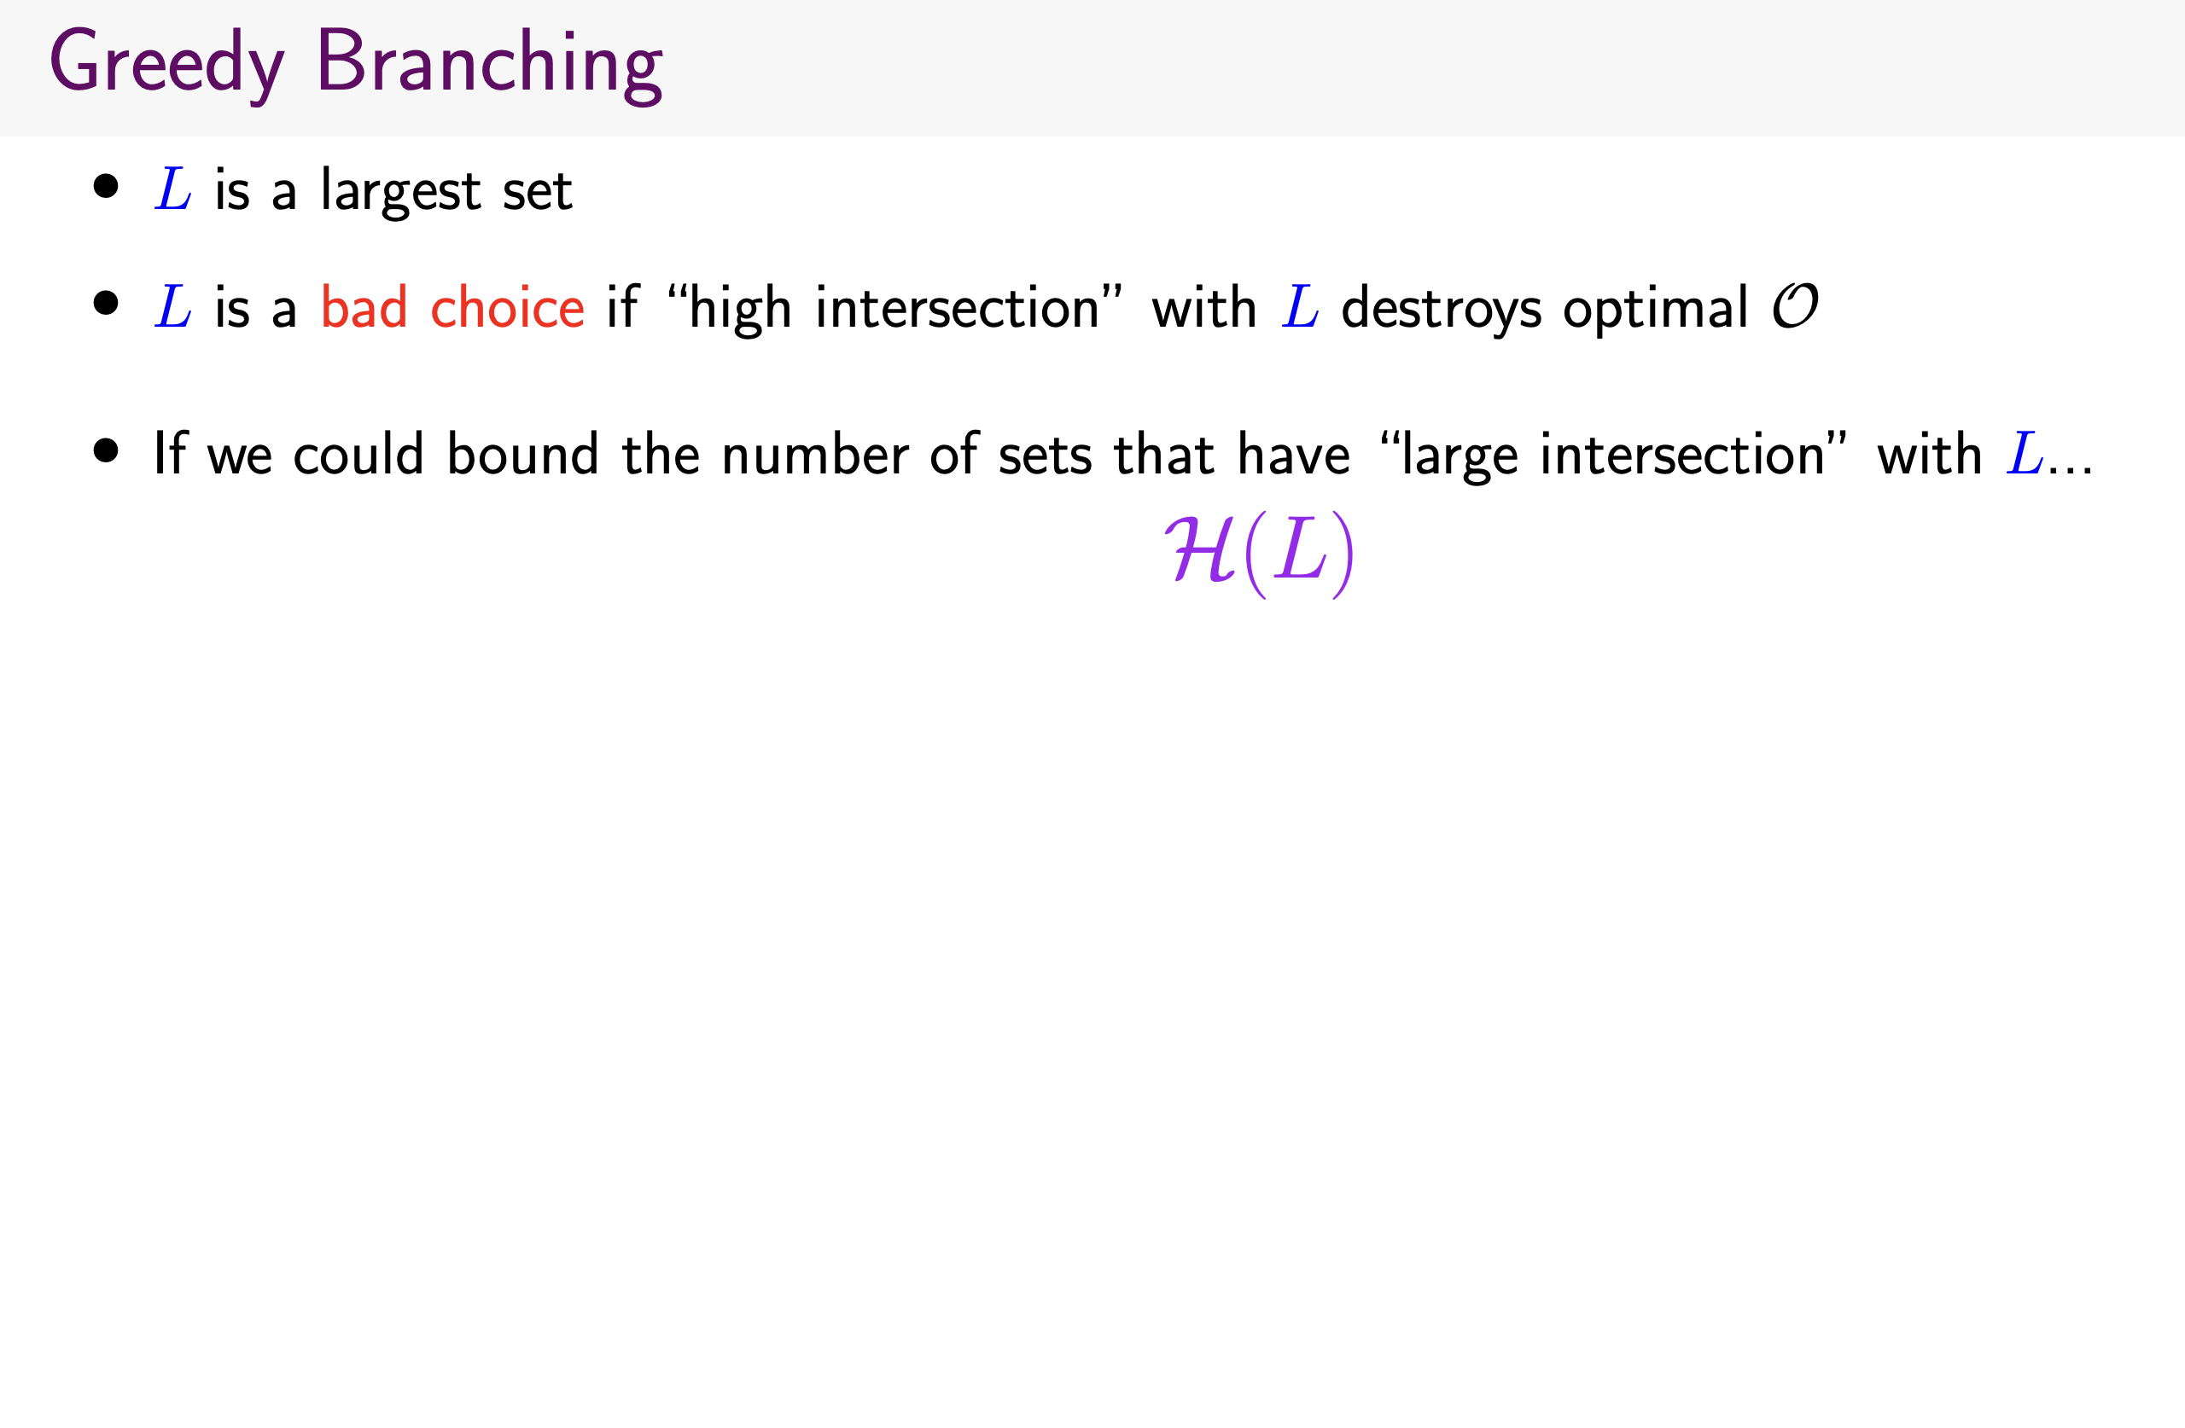

Slide 61
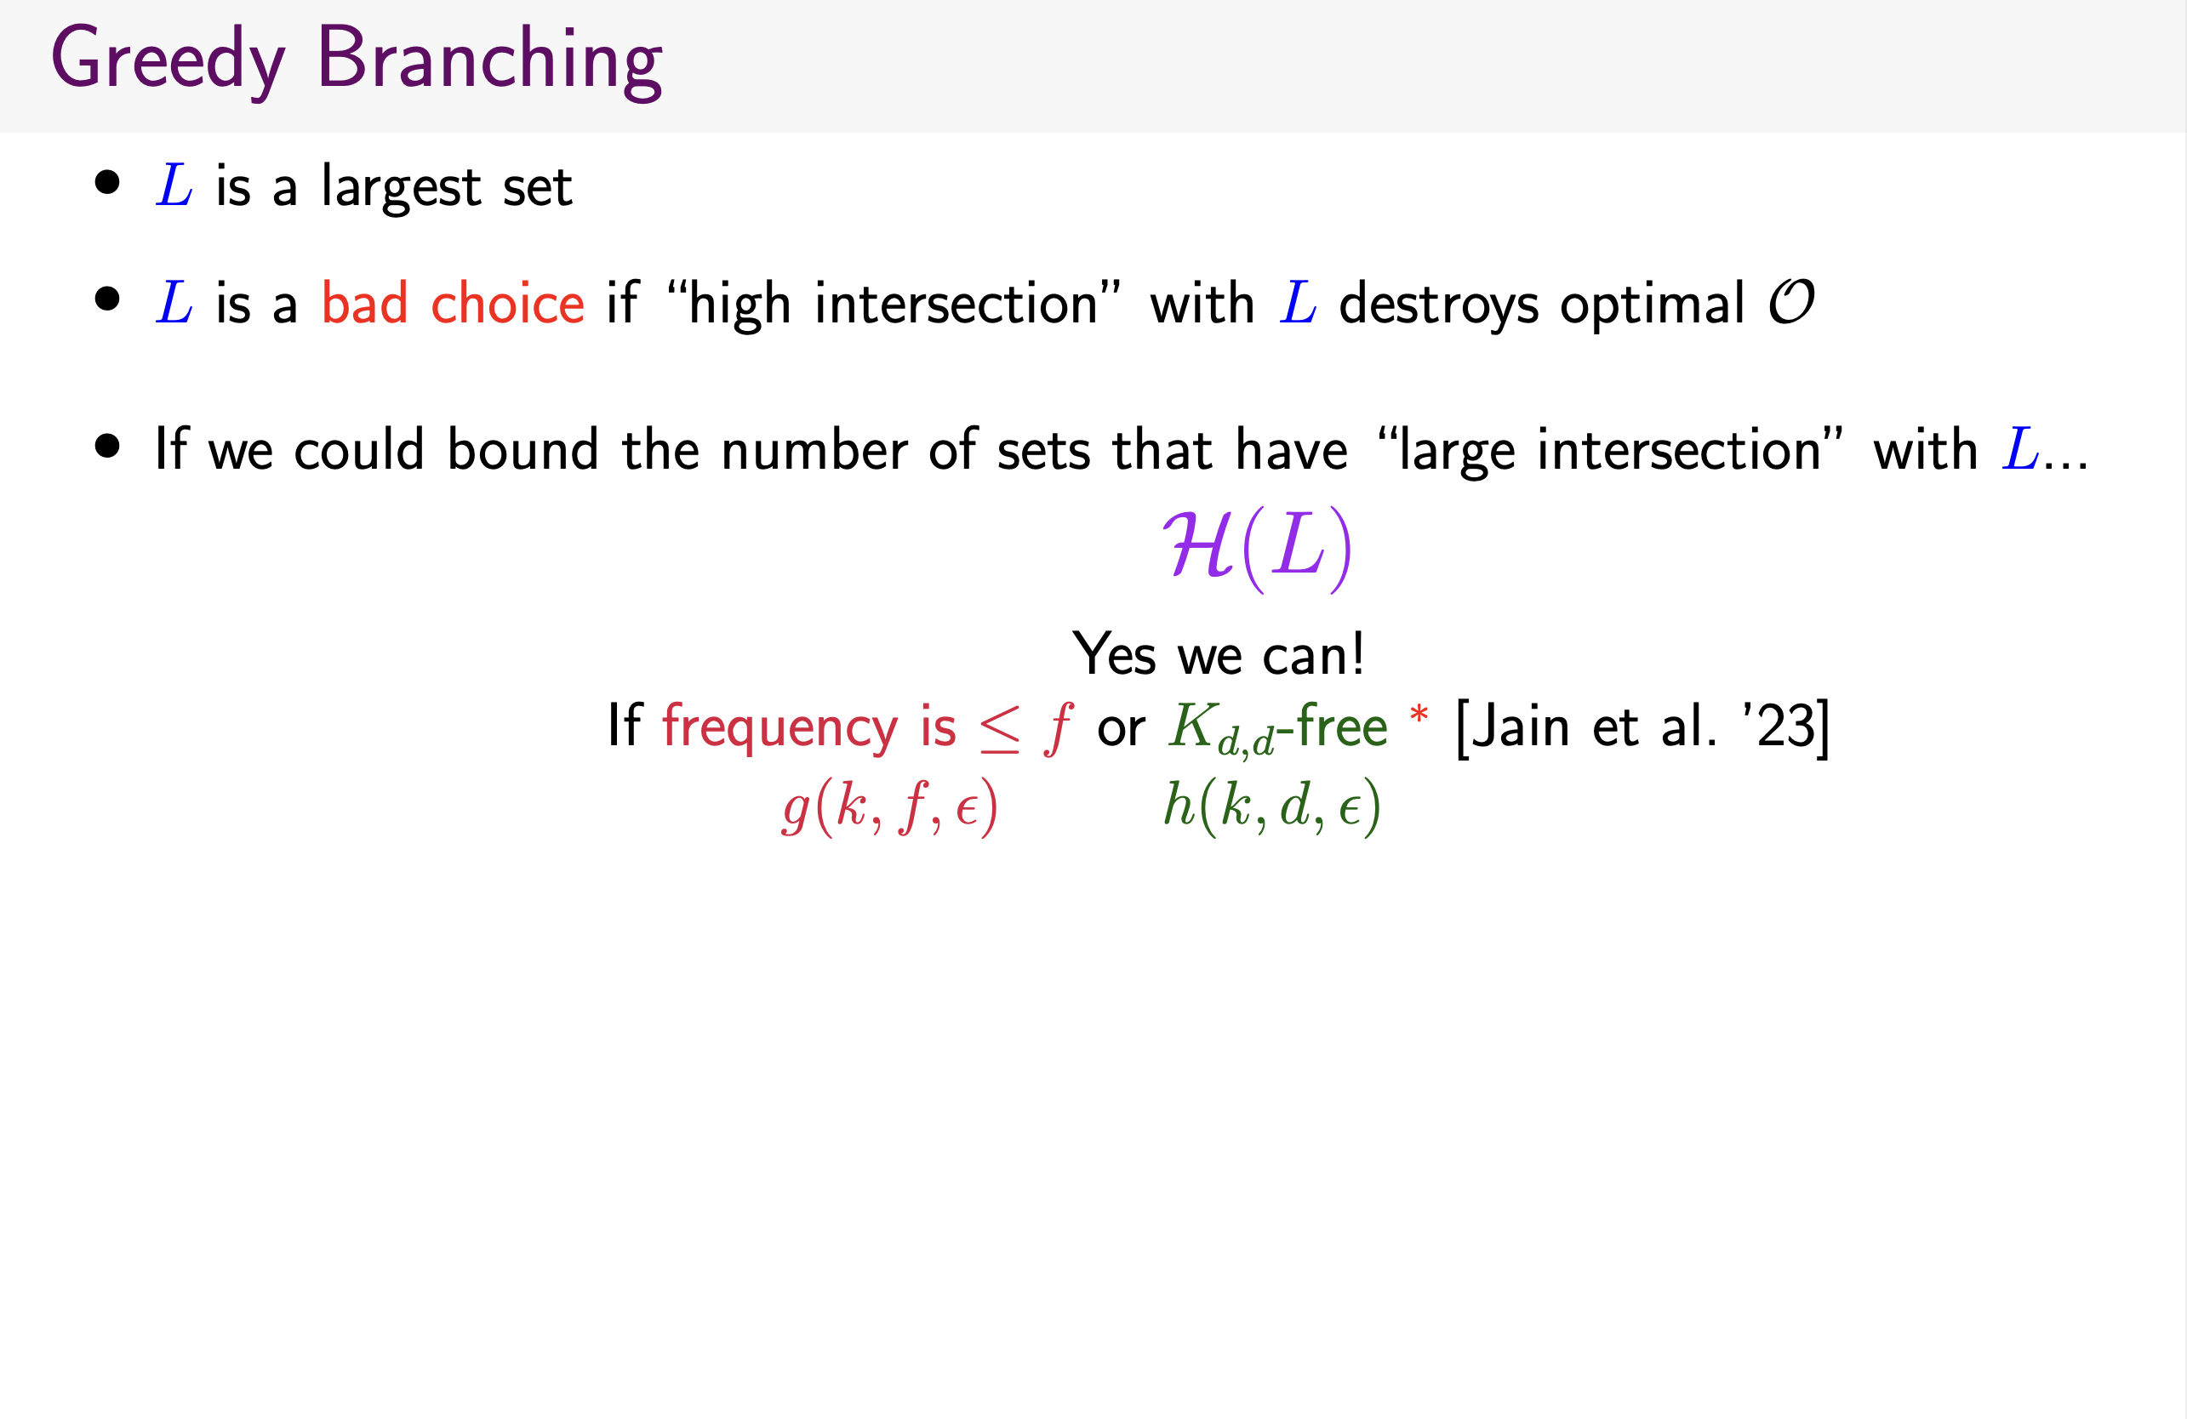

Slide 62
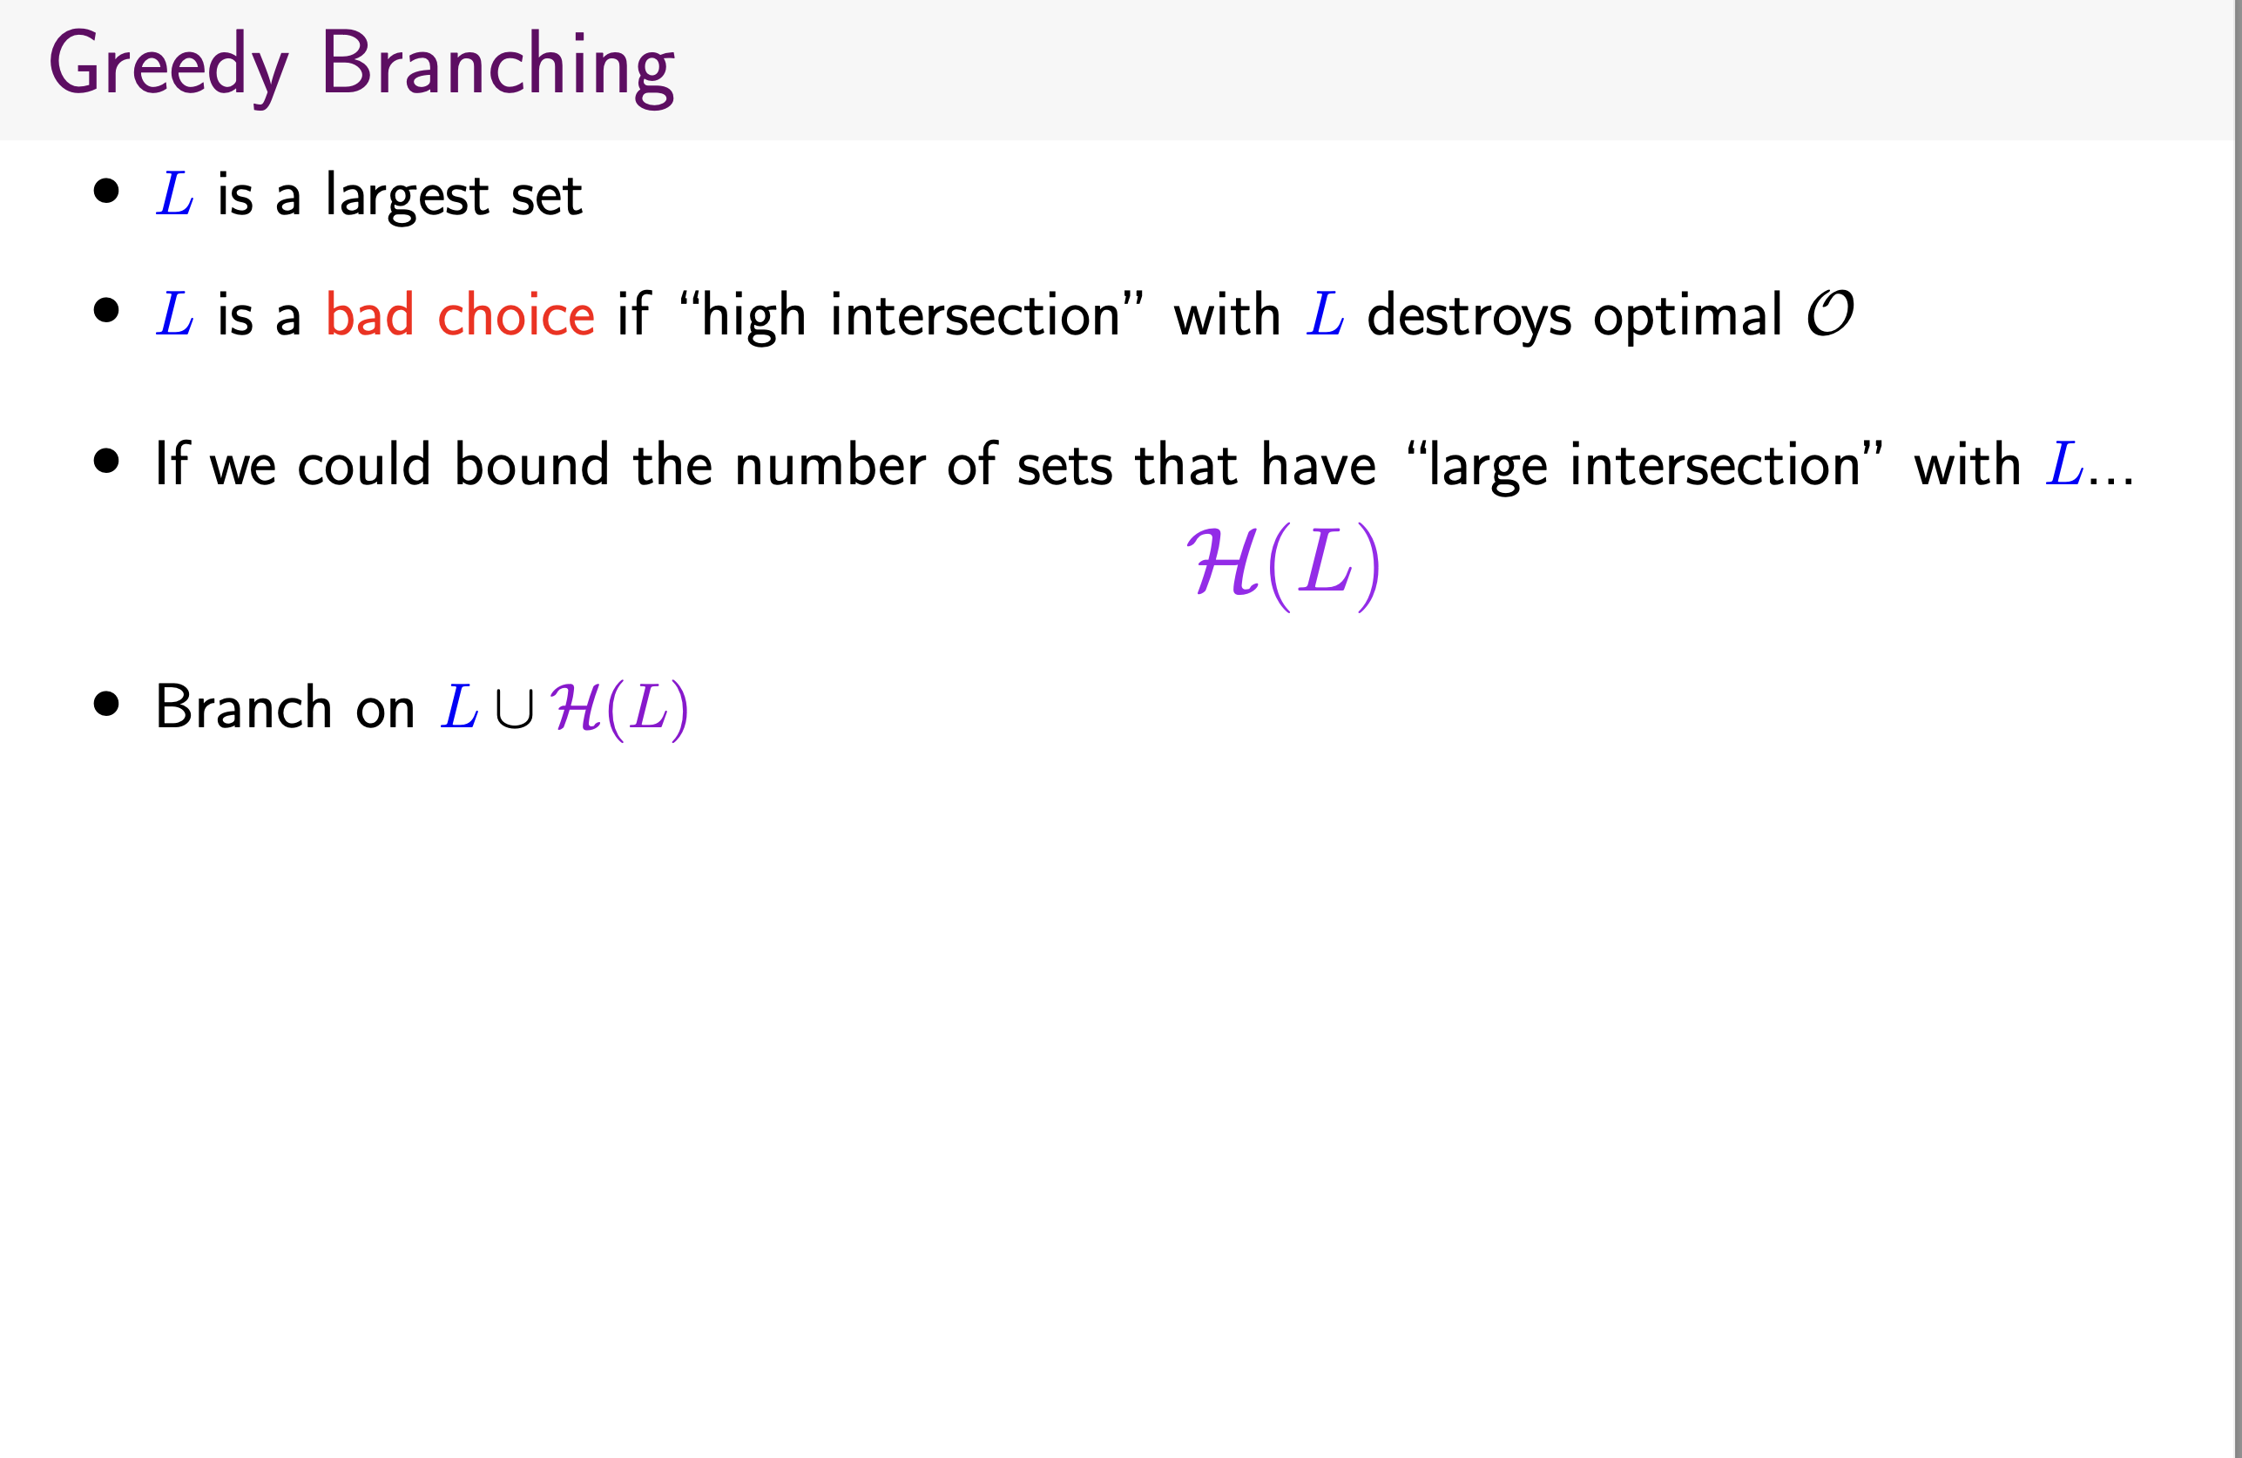

Slide 63
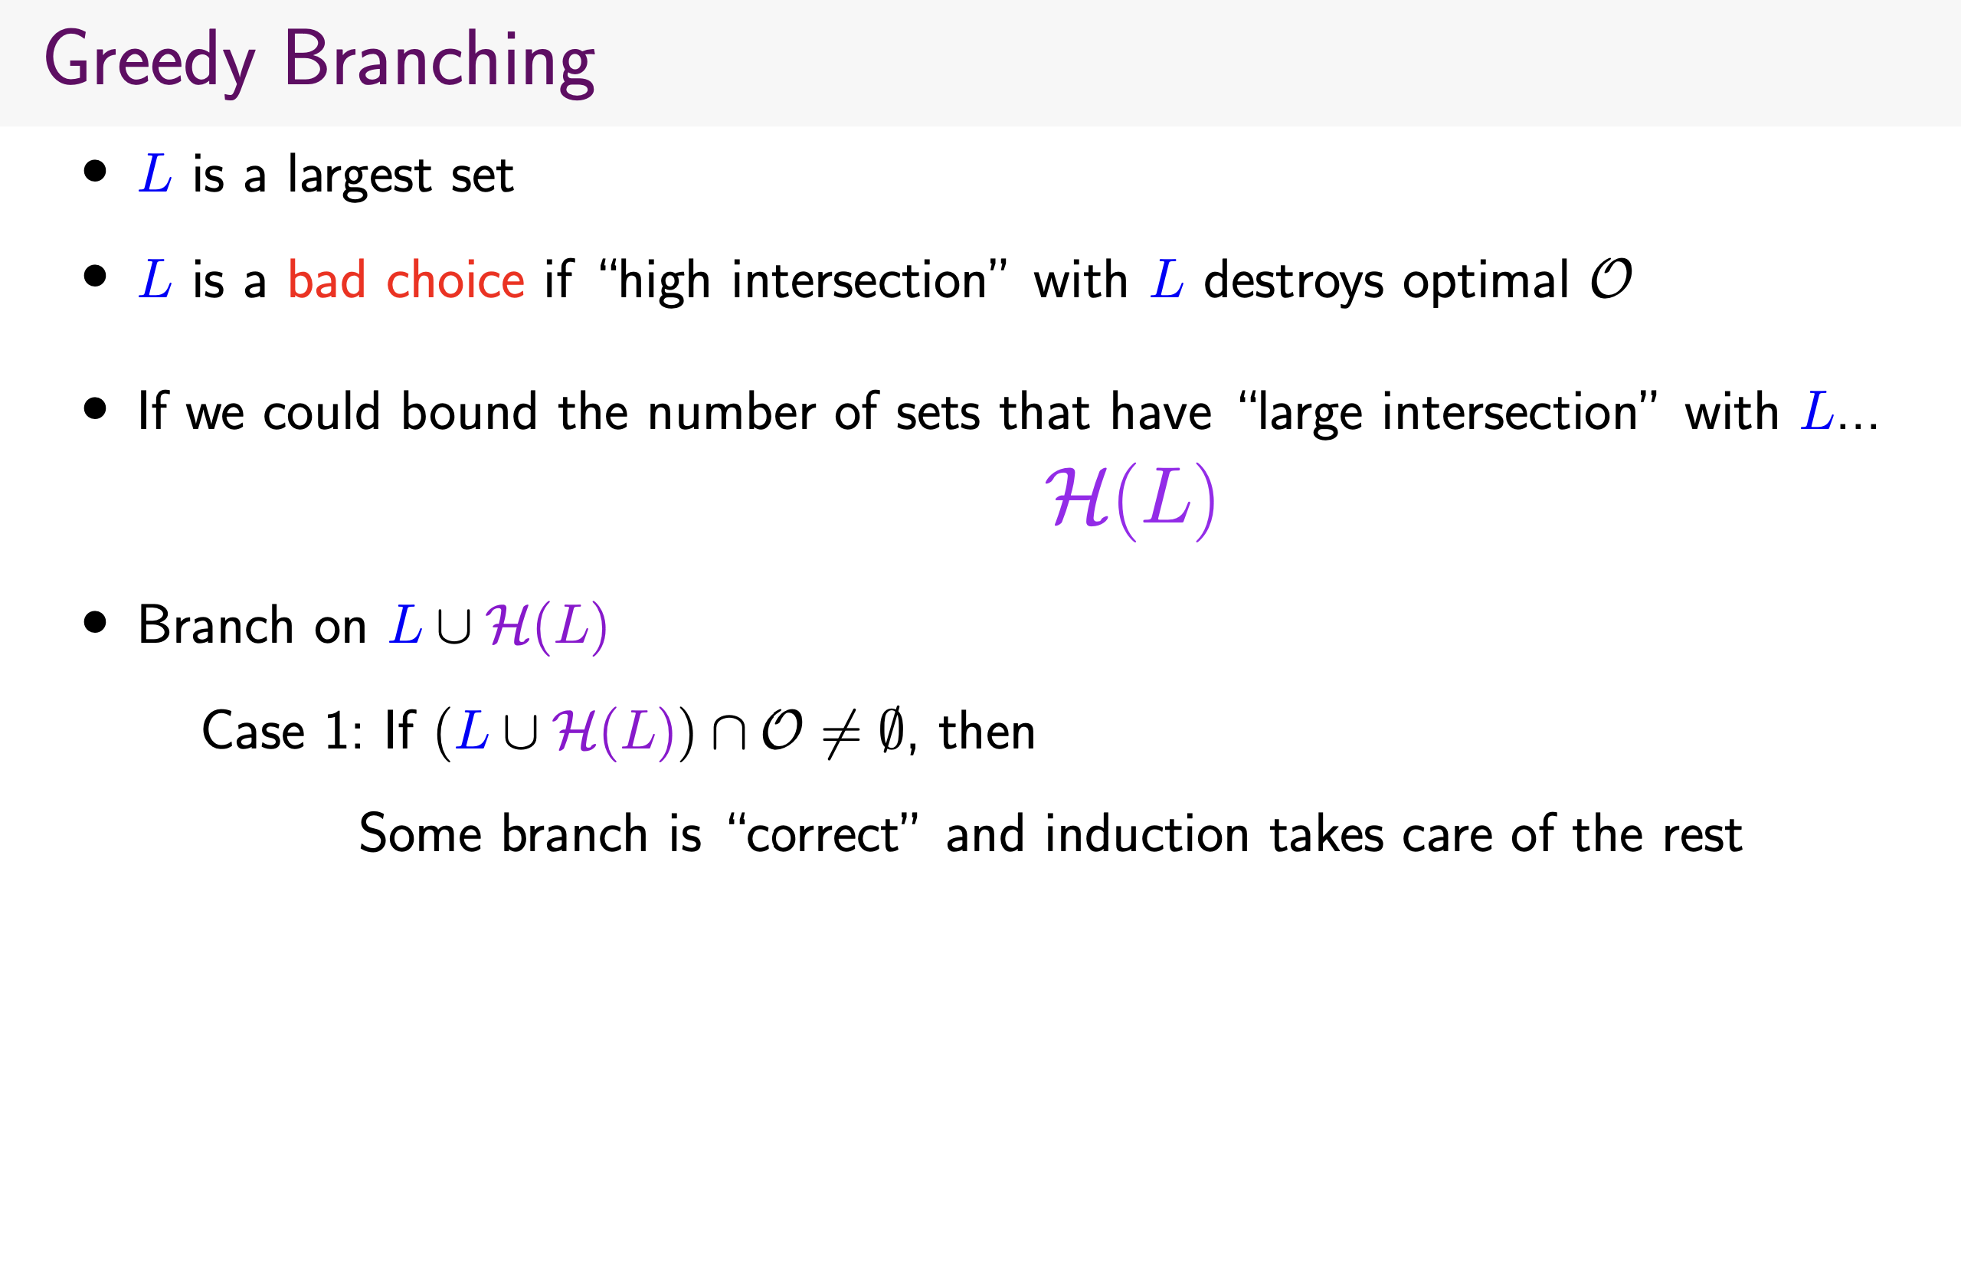

Slide 64
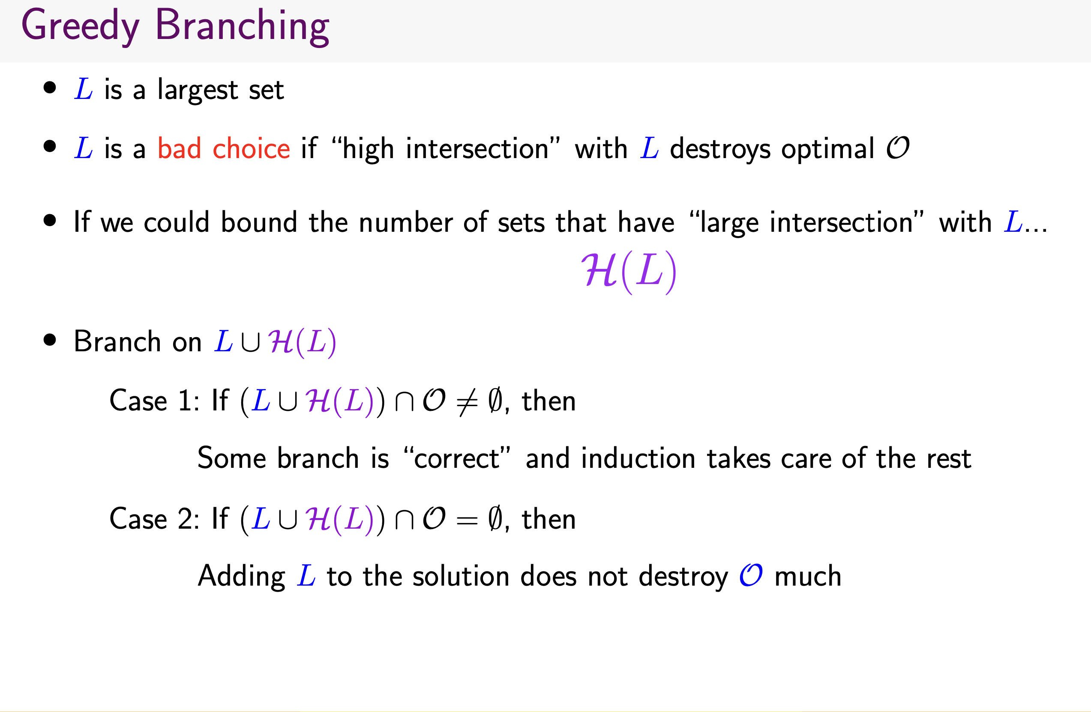

Slide 65
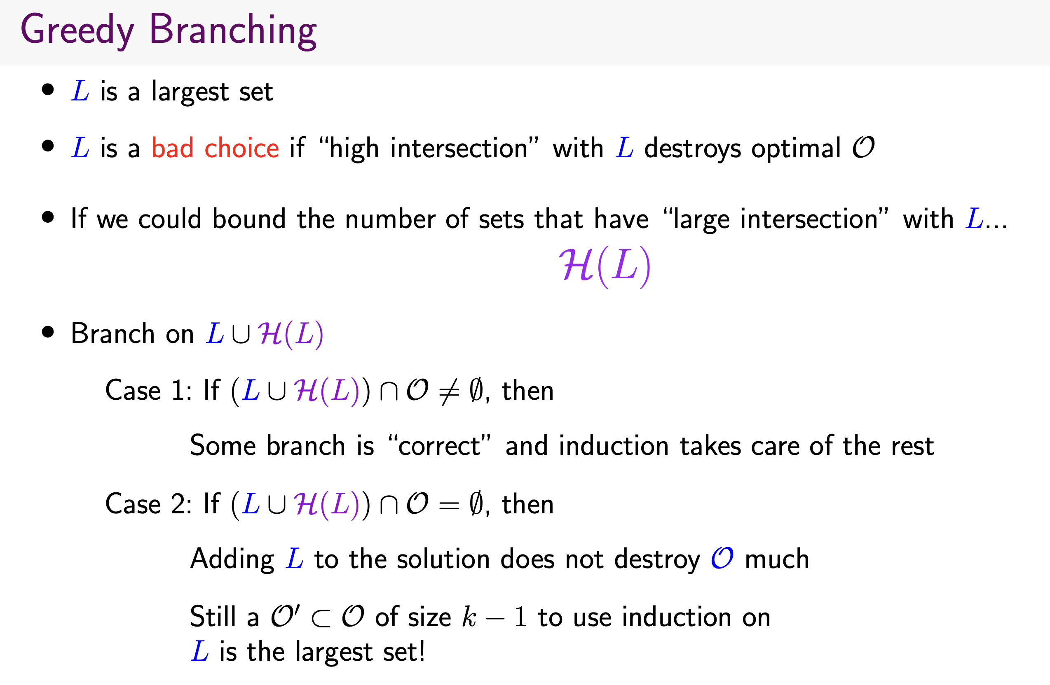

Slide 66
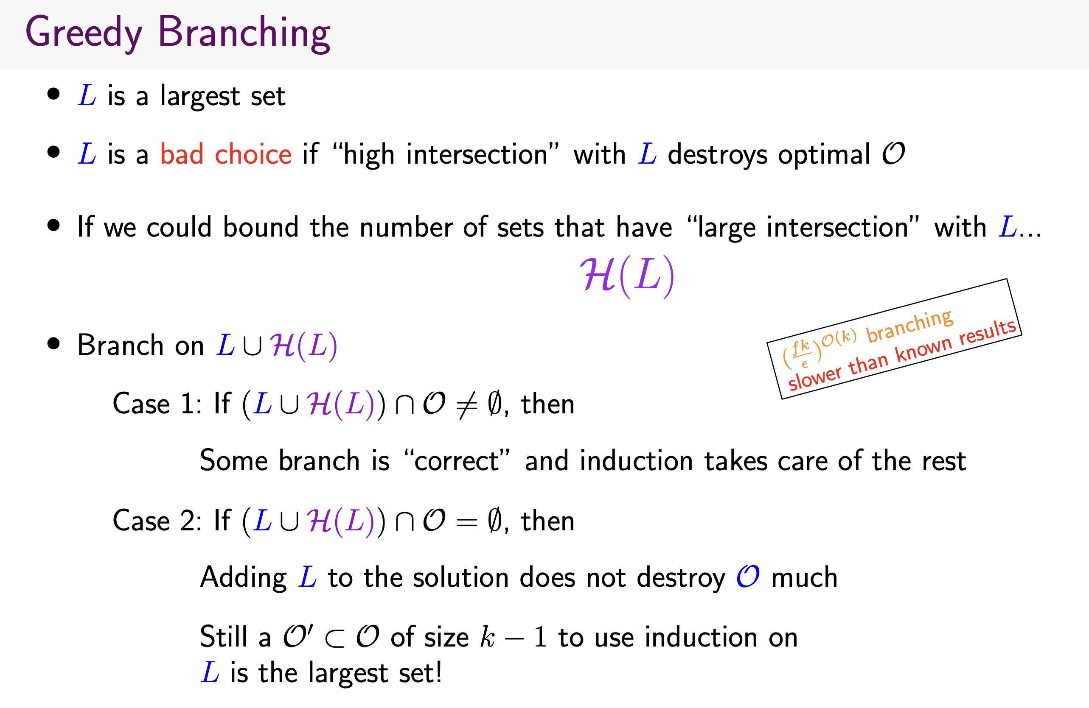

Slide 67
Idea for Approximating Covered Object
Let v be a vertex of the highest degree in A. That is, it is one of the vertex of highest degree in A.
Let S be an optimal solution. Why is v not in S?
If every vertex in A covers only ``tiny” (need to be quantified) of N(v). Then,
S-any vertex + v
is a good proposal for an approximate solution.
If this tiny is quantified, then we can conclude that there exists an approximate solution that contains v.
This means delete v and look for solution of size k-1 in G-N[v].

Slide 68
Idea for Approximating Covered Object
Let v be a vertex of the highest degree in A. That is, it is one of the vertex of highest degree in A.
If every vertex in A covers only ``tiny” (need to be quantified) of N(v). Then, S - any vertex + v is a good proposal for an approximate solution. This case does not occur!
How many vertices in A can see large number of vertices in N(v)? Given that G is a K_{dd} -free bipartite graph.
If this is small f(k,d,epsilon) – branch on them and recurse!

Slide 69
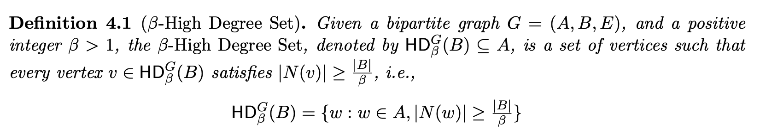
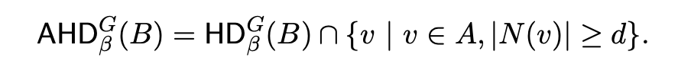
High Degree Vertices
In general, the above set is not bounded.

Slide 70
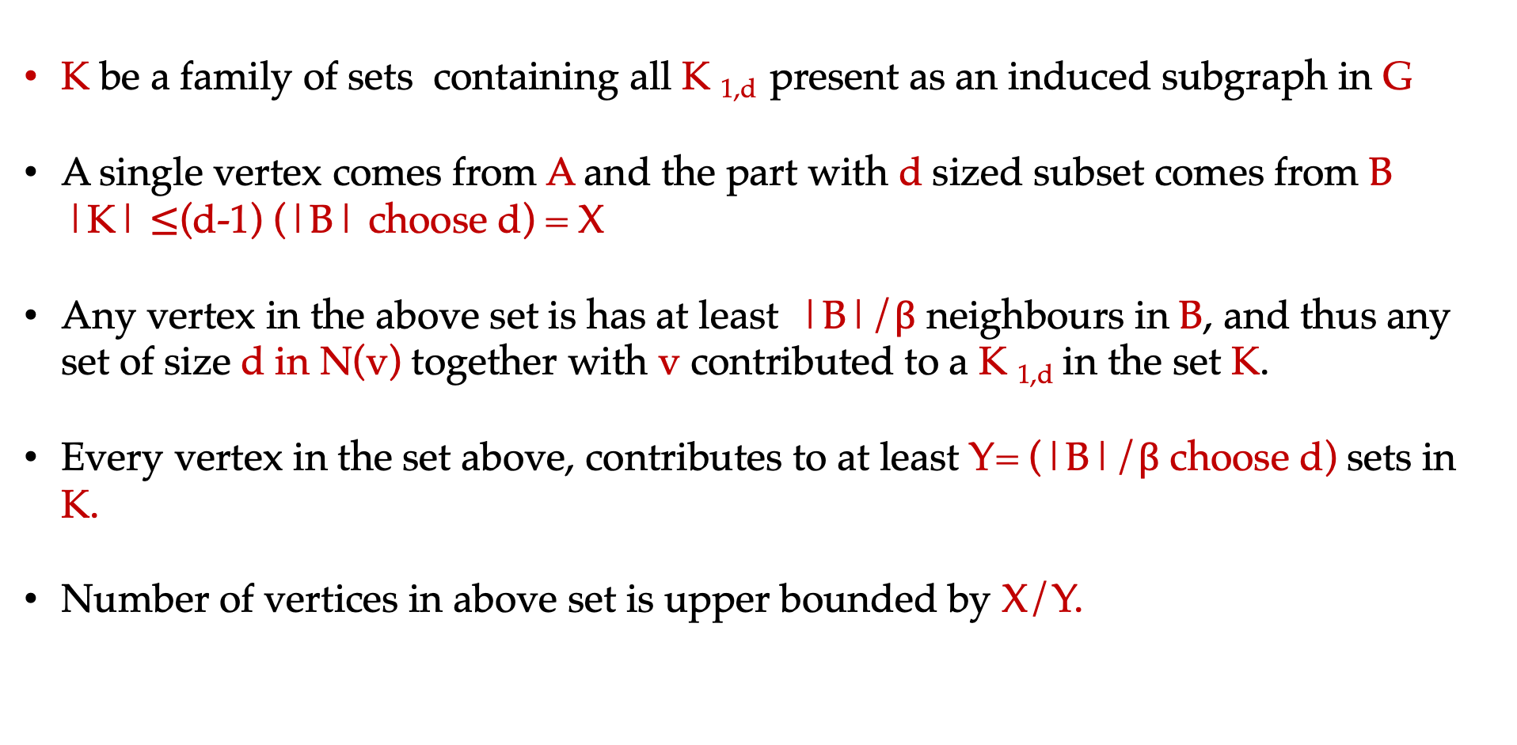
K be a family of sets containing all K _{1,d} present as an induced subgraph in G
A single vertex comes from A and the part with d sized subset comes from B
|K| $≤$(d-1) (|B| choose d) = X
Any vertex in the above set is has at least |B|/$β$ neighbours in B, and thus any set of size d in N(v) together with v contributed to a K _{1,d} in the set K.
Every vertex in the set above, contributes to at least Y= (|B|/$β$ choose d) sets in K.
Number of vertices in above set is upper bounded by X/Y.

Slide 71

Algorithm

Slide 72

CNF Formulas
Variables (V): {x₁ , x₂ , … ,x_{n}}
Clauses:
Formula: F=$⋀$ C_{i} over variables V
Assignment: A function from V to {0,1}
Satisfying Assignment: If each clause is satisfied. That is, in each clause one
of the literals (variables and its negations) is assigned 1.
Weight of an Assignment: Number of variables that are set to 1.

Slide 73

Max-SAT with Cardinality Constraint (CC)
Input: A CNF formula F=$⋀$ C_{i} over variables V and an integers k and t.
Output: An assignment of weight k that satisfies at least t clauses.
Parameter: k, t, k+t
Observe that when negation is not allowed then this is same as
Partial Hitting Set or Maximum Coverage!

Slide 74

Max-SAT-CC
[Sviridenko]: Admits (1-(1/e)) factor polynomial time approximation.
[Raghavendra and Tan; Austin and Stankovic]:
When input is 2-SAT, admits 0.929 factor polynomial time approximation.
Hard to approximate within 0.929+$ε$, for any $ε$>0.
Unless FPT=W[1], there is no f(k) n^{O(1)} time algorithm for Max-SAT-CC.
(In fact, for Max-2-SAT-CC)
Max-SAT-CC admits 2^{O(t)} n^{O(1)} time algorithm.

Slide 75

Clause Variable Incidence Graphs
x1
C₁
V={x1,x2,x3,x4,x5,x6}
C₁={x1, $¬$x2,x3}
C₂={x4,x5,x6}
C₃={x2, $¬$x4,x6}
C₄={x3, $¬$x5]
x2
C₂
x3
C₃
x4
x5
C₄
x6
A
B

Slide 76

Our Results
Theorem 1: Max-SAT-CC admits FPT-AS, when the incident graph of the formula is a K_{dd} -free bipartite graph. The algorithm runs in time
Returns an assignment of weight at most k such that (1-$ε$)OPT_{k} (F)
Here, OPT_{k} (F) denotes the maximum of number of clauses satisfied, taken over weight k assignments.

Slide 77
Our Results
Theorem 1: Max-SAT-CC admits FPT-AS, when the incident graph of the formula is a K_{dd} -free bipartite graph. The algorithm runs in time
Returns an assignment of weight at most k such that (1-epsilon)OPT_{k} (F)
Here, OPT_{k} (F) denotes the maximum of number of clauses satisfied, taken over weight k assignments.
Theorem 2 [OPEN}: Max-SAT-Approximating Solution admits ?? approximation, when F is a K_{dd} -free bipartite graph.
- Either returns that (F,k,t) is a No-instance; or returns an assignment of weight at most k+1 (or some f(k) k) such that t clauses are satisfied.
- Even for Max-SAT-2-CC

Slide 78
What Else
A randomized gap preserving reduction from
satisfiability to coverage problem (ICALP 2024)
Generalized to Fairness and Matroid constraints on
coverage and satisfiability versions (ICALP 2024)
Voting and Committee Selection (IJCAI 2025)
Capacitated Version of the problem (SODA 2025)

Slide 79
Concluding Thoughts
Phenomena of combining FPT
and Approx is quite robust and
rewarding.
Pick our favorite problem and do
FPT-Approximation for this.

Slide 80
Case Study I: Min k-Cut

Slide 81
Min k-Cut
Input:
Graph G, integer k, weight function w : E(G) → R⁺
Task:
Partition V(G) into k non-empty parts,
minimizing total weight of edges crossing the partition.

Slide 82
















NP-Complete
(even on unweighted graphs)
Poly time 2-Appx
(Greedy)
$n^{O(k^{2})}$ time
(randomized)
n^{2(k-1)} time
(randomized)
Poly time (2-$\frac{1}{k}$)-Appx
No (2-$ϵ)$-Appx in poly time
(assuming SSE-Hypothesis)
n^{2(k-1)} time
(Deterministic)
No n^{o(k)} time
(assuming ETH)
Notes:
Saran-Vazirani, Manurangsi, Goldschimth-Hochbaum, Karger-Stein, Thorup, Downey, Estevil-Castro, Fellows, Prieto, Rosamond

Slide 83


Karger-Stein Algorithm
Pick a random edge, contract it. Repeat
When k vertices left, that is your k-Cut!
For every minimum k-cut, probability to output that k-cut is $≥$ n^{-2k+O(1)}
So number of minimum k-cuts is $≤$ n^{2k+O(1)}
Number of c-approximate k-cuts is $≤$ n^{2ck+O(1)}

Slide 84
Thorup’s Tree Packing
(only show for unweighted)
Edge weight when computing tree i is
#times previous trees used that edge
Compute O(k³m log m) minimum spanning trees
At least one of these trees crosses cut $≤$ 2(k-1) times
Guess this tree: O(k³m log m) = O(n²)
Guess the cut edges: O(n^{2k-2})
Guess how to merge 2k-1 components into k groups: k^{O(k)}
Total time: k^{O(k)}n^{2k}

Slide 85
The past 10 years
Improve the constant of n^{2k} exact algorithm as far as possible
Find tight n^{ck} bound on number of minimum k-cuts
Parameterized Approximation (with parameter k)
Parameterized Algorithms with parameter s = cut size

Slide 86







Exact XP Algorithms and #Minumum k-Cuts
Li [2019]
Gupta et al [2018a]
k^{O(k)}$n^{\frac{2ω}{3}k+O(1)}$
k^{O(k)}$n^{k+o(k)}$
(Unweighted)
(Unweighted)
Gupta et al [2020]
Gupta et al [2019]
$$n^{k+o(k)}$$
k^{O(k)}$n^{1.98k+o(k)}$
Bound for #min k-Cuts
Bound for #min k-Cuts
Tight!

Slide 87














Parameterized by Cut Size s
Kawarabayashi and Thorup [2011]
$$s^{s^{O(s)}}n^{O(1)}$$
Chitnis et al. [2016]
$$s^{{O(s}^{2})}n^{O(1)}$$
Cygan et al. [2018]
$$s^{O(s)}n^{O(1)}$$
Maybe 2^{O(s)}n^{O(1)} ?
Probably no 2^{o(s)}n^{O(1)} ?

Slide 88






Parameterized Approximation
Gupta et al [2018b]
Kawarabayashi and Lin [2020]
1.9997-appx in time $2^{O(k^{6}) }n^{O(1)}$
1.67-appx in $k^{O(k^{2}) }n^{O(1)}$
Gupta et al [2018a]
(1+$ϵ$)-appx in time ${{(k/ϵ)}^{O(k)}n}^{k+o(k) }n^{O(1)}$
1.81-appx in $2^{O(k^{2}) }n^{O(1)}$

Slide 89
The past 10 years summaried
Improve the constant of n^{2k} exact algorithm as far as possible
Find tight n^{ck} bound on number of minimum k-cuts
Parameterized Approximation (with parameter k)
?
Parameterized Algorithms with parameter s = cut size
?

Slide 90

Our results
(1+$ϵ$)-approximation algorithm in time ${(k/ϵ)}^{O(k)}n^{O(1)}$
Exact algorithm in time $s^{O(k)}n^{O(1)}$ for unweighted graphs,
shere s = cut size.
Both are optimal up to ETH and constants in exponent

Slide 91
Our main result
(1+$ϵ$)-approximation algorithm in time ${(k/ϵ)}^{O(k)}n^{O(1)}$
Optimal up to ETH and constants in exponent
Parameterized Approximation (with parameter k)

Slide 92

Proof ingredients
(1+$ϵ$)-approximate reduction to OPT $=$ O($\frac{k \log{n}}{ϵ^{3}}$)
Polynomial time tree decomposition with (s^{O(1)},s) unbreakable bags
s^{O(k)} time exact algorithm

Slide 93
Making it Unweighted

Slide 94
Reducing the OPT

Slide 95
Graph Decomposition

Slide 96
Dynamic Programming

Slide 97
Maximum Coverage
Input: A universe U of n elements and m subsets F={S₁, S₂,….,S_{m}} and an integer k.
Maximum Coverage Problem: Find k sets such that its union is as large as possible.
Set Cover: Find a minimum number of sets such that its union covers the universe U.

